Slide 1




Position-Based
Quantum Cryptography:
Impossibility and Constructions
Christian Schaffner
CWI Amsterdam, Netherlands
joint work with
Harry Buhrman, Nishanth Chandran, Serge Fehr,
Ran Gelles, Vipul Goyal and Rafail Ostrovsky (UCLA)
Seminar
Eindhoven, Netherlands
Wednesday, 3 November 2010

Slide 2
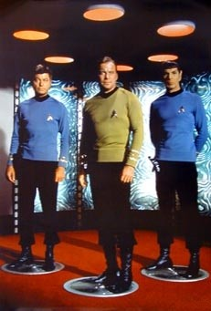
Outline
Quantum Computing & Teleportation
Position-Based Cryptography
Impossibility of
Position-Based Quantum Cryptography
Constructions
Summary & Open Questions

Slide 3
Quantum Bit: Polarization of a Photon

Slide 4
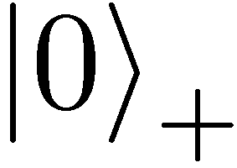
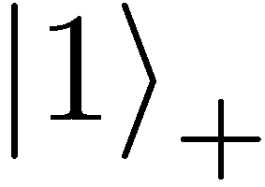
Qubit: Rectilinear/Computational Basis

Slide 5

Detecting a Qubit
no photon: 0
Alice
Bob

Slide 6
Measuring a Qubit
no photon: 0
photon: 1
Alice
Bob
measurement:
with prob. 1 yields 1
0/1

Slide 7
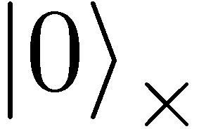
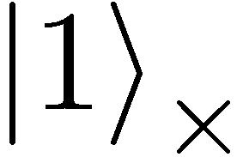
Diagonal/Hadamard Basis
Measurement:
with prob. ½ yields 0
with prob. ½ yields 1
0/1

Slide 8
Quantum Mechanics
+ basis
£ basis
Measurements:
with prob. 1 yields 1
0/1
with prob. ½ yields 0
0/1
with prob. ½ yields 1

Slide 9

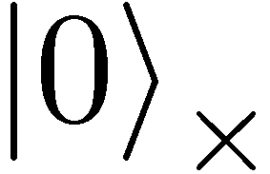
Quantum Operations
are linear isometries
can be described by a unitary matrix:
examples:
  identity
  bitflip (Pauli X): mirroring at axis
X
X
X
X

Slide 10

Quantum Operations
are linear isometries
can be described by a unitary matrix:
examples:
  identity
  bitflip (Pauli X): mirroring at axis
  phase-flip (Pauli Z): mirroring at axis
  both (Pauli XZ)
Z

Slide 11
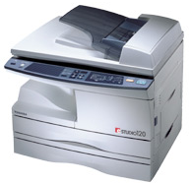
No-Cloning Theorem
X
Z
XZ
U
?
?
?
Proof: copying is a non-linear operation

Slide 12


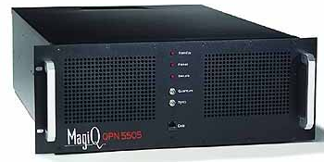

Quantum Key Distribution (QKD)
[Bennett Brassard 84]
Alice
Bob
Eve
inf-theoretic security against unrestricted eavesdroppers:
  quantum states are unknown to Eve, she cannot copy them
  honest players can check whether Eve interfered
technically feasible: no quantum computation required,
only quantum communication

Slide 13
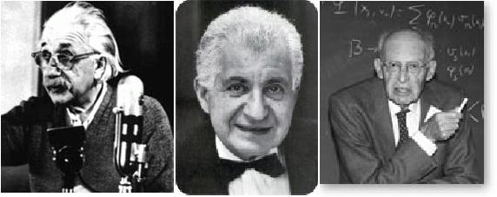
EPR Pairs
[Einstein Podolsky Rosen 1935]
prob. ½ : 0
prob. ½ : 1
EPR magic!
prob. 1 : 0
“spukhafte Fernwirkung” (spooky action at a distance)
EPR pairs do not allow to communicate
(no contradiction to relativity)
can provide a shared random bit
(or other non-signalling correlations)

Slide 14
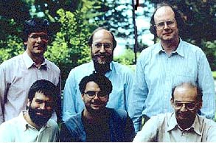
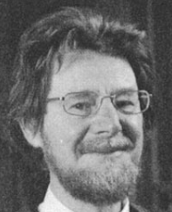
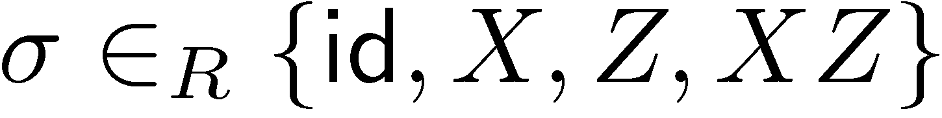



Quantum Teleportation
[Bennett Brassard Crépeau Jozsa Peres Wootters 1993]
?
[Bell]
?
?
does not contradict relativity
teleported state can only be recovered
when the classical information ¾ arrives
with probability 1/4, no correction is needed

Slide 15
Outline
Quantum Computing & Teleportation
Position-Based Cryptography
Impossibility of
Position-Based Quantum Cryptography
Constructions
Summary & Open Questions

Slide 16
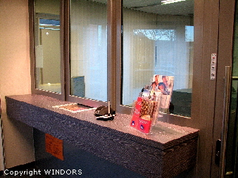
Motivation
Typically, cryptographic players use credentials such as
  secret information
  authenticated information
  biometric features
can the geographical location used as (only) credential?
examples of desirable primitives:
  position-based secret communication (e.g. between military bases)
  position-based authentication
  position-based access control to resources

Slide 17



Basic task: Position Verification
Verifier1
Prover
Verifier2
Prover wants to convince verifiers that she is at a particular position
assumptions:  communication at speed of light
            instantaneous computation
            verifiers can coordinate
no coalition of (fake) provers, i.e. not at the claimed position, can convince verifiers

Slide 18




Position Verification: First Try
Verifier1
Prover
Verifier2
time

Slide 19
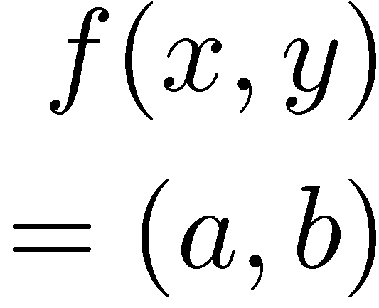


Position Verification: Second Try
Verifier1
Prover
Verifier2

Slide 20

Impossibility of Classical Position Verification
[Chandran Goyal Moriarty Ostrovsky: CRYPTO ‘09]
position verification is classically impossible !
using the same resources as the honest prover,
colluding adversaries can reproduce a consistent view
computational assumptions do not help

Slide 21



Position-Based Quantum Cryptography
[Kent Munro Spiller 03/10, Chandran Fehr Gelles Goyal Ostrovsky, Malaney 10]
Verifier1
Prover
Verifier2
?
intuitively: security follows from no cloning
formally, usage of recently established [Renes Boileau 09]
entropic quantum uncertainty relation

Slide 22


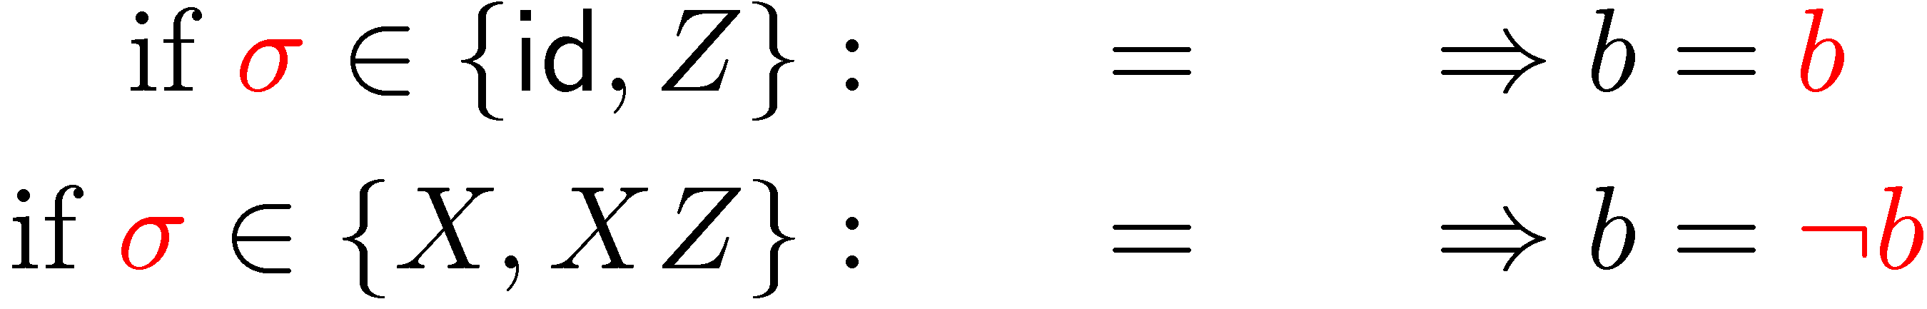
Position-Based QC: Teleportation Attack
[Kent Munro Spiller 03/10, Lau Lo 10]

Slide 23

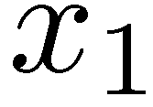
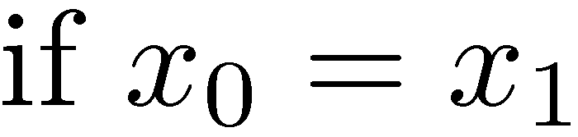
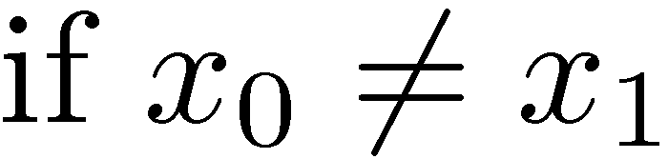
Position Verification: Fourth Try
[Kent Munro Spiller 03/10, Malaney 10, Lau Lo 10]
?
?
?
however: insecure if adversaries share two EPR pairs!
are there secure quantum schemes at all?

Slide 24
Outline
Quantum Computing & Teleportation
Position-Based Cryptography
Impossibility of
Position-Based Quantum Cryptography
Constructions
Summary & Open Questions

Slide 25

Impossibility of Position-Based Q Crypto
[Buhrman Chandran Fehr Gelles Goyal Ostrovsky S 10]
attack on general position-verification scheme
distributed quantum computation with
one simultaneous round of communication

Slide 26
Distributed Q Computation in 2 Rounds
U
trivial to do in two rounds

Slide 27
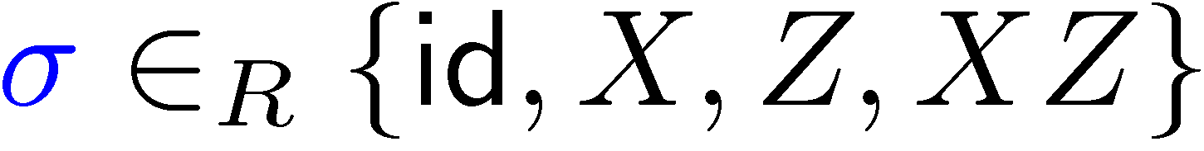



Distributed Q Computation in 2 Rounds
U
trivial to do in two rounds
also using only classical communication

Slide 28
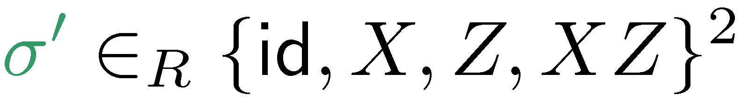

Distributed Q Computation in 1 Round
U
clever way of back-and-forth teleportation, based on ideas by [Vaidman 03] for “instantaneous measurement of nonlocal variables”

Slide 29

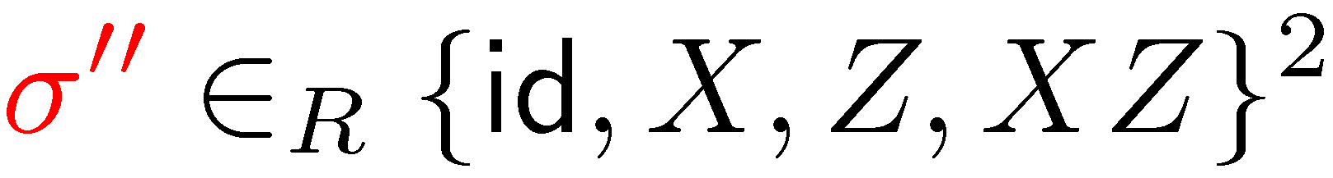


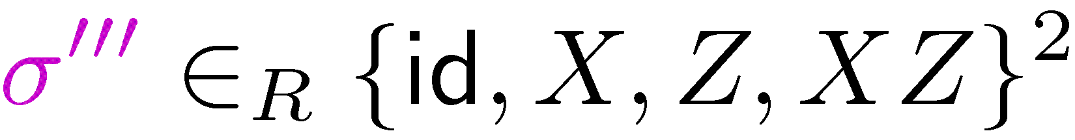

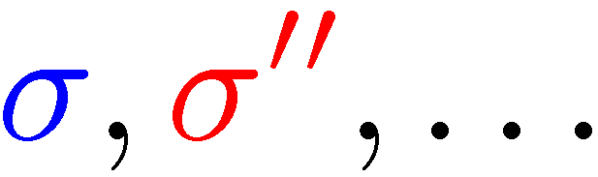

Distributed Q Computation in 1 Round
U

Slide 30
Distributed Q Computation in 1 Round

Slide 31
Distributed Q Computation in 1 Round
the number of required EPR pairs grows exponentially with the number of recursion levels

Slide 32
Distributed Q Computation: Analysis
in every layer of recursion, there is a
constant probability of success.
invariant: except for the last teleportation step, Bob can completely trace back and correct previous errors.
using an exponential amount of EPR pairs, players succeed with probability arbitrarily close to 1
scheme generalizes to more players
Hence, position-based quantum cryptography is impossible!

Slide 33
Outline
Quantum Computing & Teleportation
Position-Based Cryptography
Impossibility of
Position-Based Quantum Cryptography
Constructions
Summary & Open Questions

Slide 34
Position-Based Quantum Cryptography
?
reasoning only valid in the no-preshared entanglement
(No-PE) model
Theorem: success probability of attack is at most 0.89
use (sequential) repetition to amplify gap between honest and dishonest players

Slide 35
Position-Based Authentication and QKD
verifiers accept message only if sent from prover’s position
weak authentication:
  if message bit = 0 : perform Position Verification (PV)
  if message bit = 1 : PV with prob 1-q, send ? otherwise
strong authentication by encoding message into balanced-repetition-code (0 → 00…0011…1 , 1 → 11…1100…0 )
verifiers check statistics of ? and success of PV
using authentication scheme, verifiers can also perform
position-based quantum key distribution

Slide 36
Summary
intro to Quantum Computing & Teleportation
Verifier1
Prover
Verifier2
plain model: classically and quantumly impossible
basic scheme for secure positioning if adversaries have no pre-shared entanglement
more advanced schemes allow message authentication and key distribution
can be generalized to more dimensions

Slide 37
Open Questions
Verifier1
Prover
Verifier2
no-go theorem vs. secure schemes
how much entanglement is required to break the scheme?
security in the bounded-quantum-storage model?
many interesting connections to
entropic uncertainty relations and non-local games

