Slide 1


Quantum Cryptography
Christian Schaffner
Institute for Logic, Language and Computation (ILLC)
University of Amsterdam
Centrum Wiskunde & Informatica
DESDA symposium, Nijmegen
Friday, 5 June 2015

Slide 2
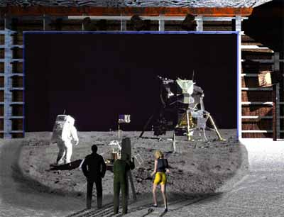
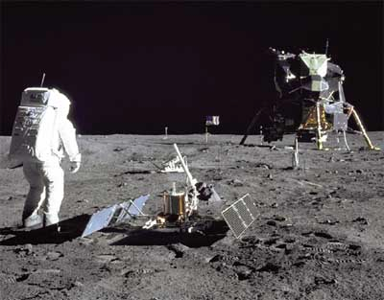
1969: Man on the Moon
The Great Moon-Landing Hoax?
NASA
http://www.unmuseum.org/moonhoax.htm
How can you prove that you are at a specific location?
Notes:
In 1969, man has first set foot on the moon, as you can see here on this picture sent around the world by NASA...
Or not? Maybe it was all just a “great moon-landing hoax”, as speculated on various conspiracy-theory websites on the internet?
One fascinating cryptographic question I want to study in my project is: “How can you prove that you are at a specific location?”
More about it later…

Slide 3
What will you learn from this Talk?
Classical Cryptography
Quantum Mechanics
Quantum Key Distribution
Position-Based Cryptography
Notes:
only scattered relations to logic, I’m afraid

Slide 4
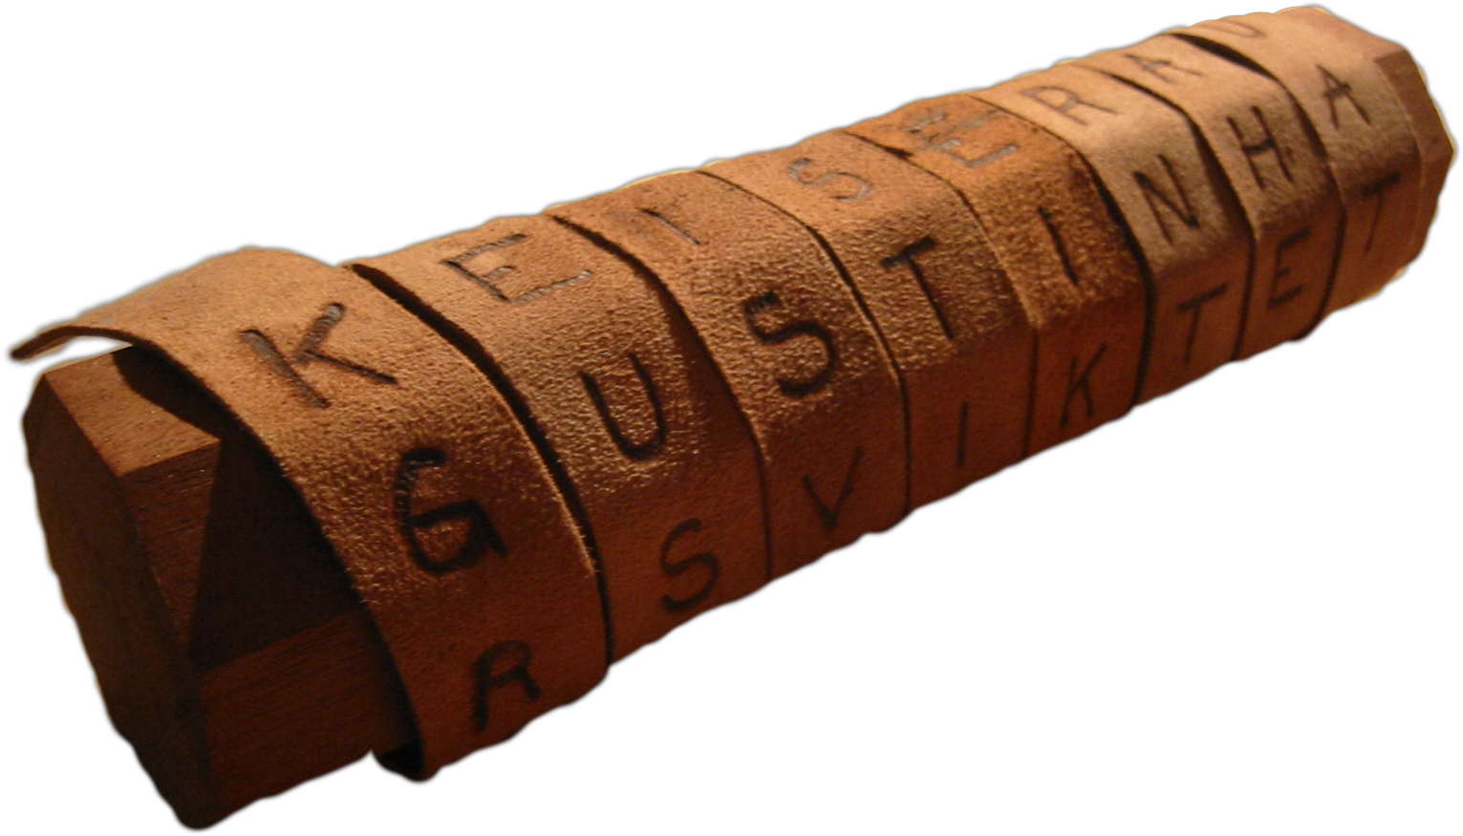
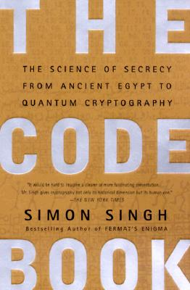
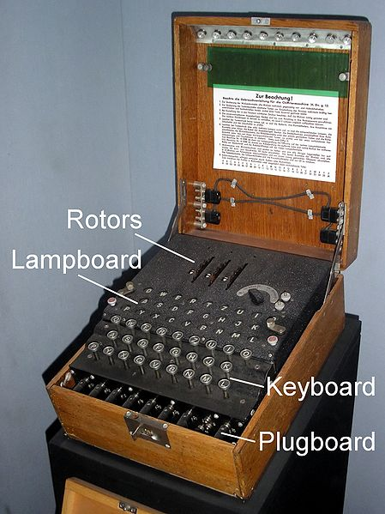
Classical Cryptography
3000 years of fascinating history
Until 1970: private communication was the only goal
Scytale
Enigma

Slide 5
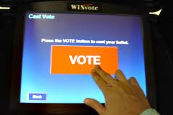
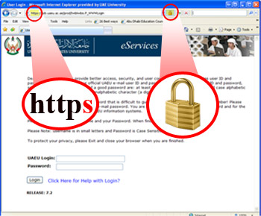
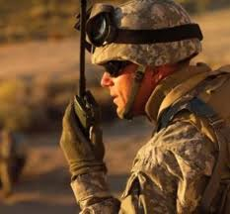
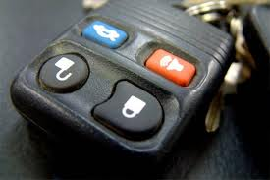
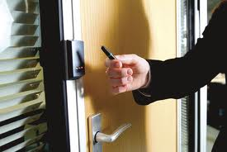
Modern Cryptography
is everywhere!
is concerned with all settings where people do not trust each other

Slide 6



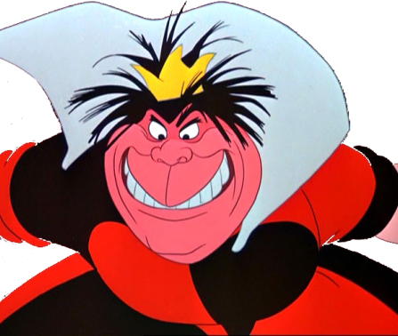
Secure Encryption
m = “I love you”
m = 0000 1111
Alice
Bob
k = ?
Eve
k = 0101 1011
k = 0101 1011
Goal: Eve does not learn the message
Setting: Alice and Bob share a secret key k

Slide 7
eXclusive OR (XOR) Function
7
x | y | x © y
0 | 0 | 0
1 | 0 | 1
0 | 1 | 1
1 | 1 | 0
Some properties:
  8 x : x © 0 = x
  8 x : x © x = 0
  ) 8 x,y : x © y © y = x
Notes:
quick check: please raise your hand if you have NOT seen this function before.
Please raise your hand if you HAVE seen this function before.
Now raise your hand if you have not raised your hand yet. For the people raising their hand now: you should seriously double-check the logic “axiom of the excluded middle”, asserting that either you HAVE seen this function before, or that you have NOT.

Slide 8
One-Time Pad Encryption
8
m = 0000 1111
c = m © k = 0101 0100
m = c © k = 0000 1111
Alice
Bob
k = ?
Eve
k = 0101 1011
k = 0101 1011
Goal: Eve does not learn the message
Setting: Alice and Bob share a key k
Recipe:
Is it secure?
x | y | x © y
0 | 0 | 0
0 | 1 | 1
1 | 0 | 1
1 | 1 | 0
m = 0000 1111
c = 0101 0100
k = 0101 1011
k = 0101 1011
c = m © k = 0101 0100
c © k = 0000 1111
c © k = m © k © k = m © 0 = m

Slide 9
Perfect Security
9
m = ?
c = m © k = 0101 0100
m = c © k = ?
Alice
Bob
k = ?
Eve
k = ?
k = ?
Given that c = 0101 0100,
  is it possible that m = 0000 0000 ?
    Yes, if k = 0101 0100.
  is it possible that m = 1111 1111 ?
    Yes, if k = 1010 1011.
  it is possible that m = 0101 0101 ?
    Yes, if k = 0000 0001
In fact, every m is possible.
Hence, the one-time pad is perfectly secure!
x | y | x © y
0 | 0 | 0
0 | 1 | 1
1 | 0 | 1
1 | 1 | 0

Slide 10
Problems With One-Time Pad
10
m = 0000 1111
c = m © k = 0101 0100
m = c © k = 0000 1111
Alice
Bob
k = ?
Eve
k = 0101 1011
k = 0101 1011
The key has to be as long as the message.
The key can only be used once.
In practice, other encryption schemes (such as AES) are used which allow to encrypt long messages with short keys.
One-time pad does not provide authentication:
Eve can easily flip bits in the message
Notes:
for encrypting internet traffic

Slide 11
Symmetric-Key Cryptography
11
Alice
Bob
Eve
Encryption ensures secrecy:
Eve does not learn the message, e.g. one-time pad
Authentication ensures integrity:
Eve cannot alter the message
General problem: players have to exchange a key to start with

Slide 12
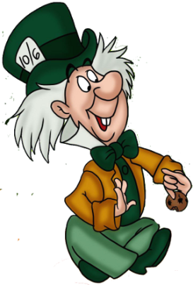
Public-Key Cryptography
12
Alice
Charlie
Bob
secret key
Eve
public key
Solves the key-exchange problem.
Everyone can encrypt using the public key.
Only the holder of the secret key can decrypt.
Digital signatures: Only secret-key holder can sign, but everyone can verify signatures using the public-key.

Slide 13
RSA Public-Key Encryption
13
Alice
Charlie
secret key
Eve
public key
Key generation: pick two large primes p and q, set N=p*q
public key: N, e 2 Z_{N}* , secret key: d = e⁻¹ mod Á(N)
Enc_{pk}(m) = m^{e} mod N
Dec_{sk}(c) = c^{d} mod N
security relies on the difficulty of factoring N, because Á(N)=(p-1)(q-1)

Slide 14
What will you Learn from this Talk?
Classical Cryptography
Quantum Mechanics
Quantum Key Distribution
Position-Based Cryptography

Slide 15
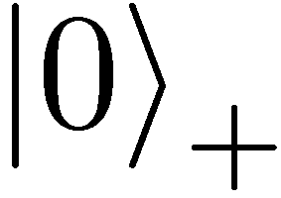
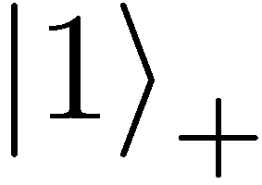
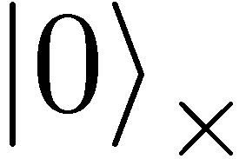
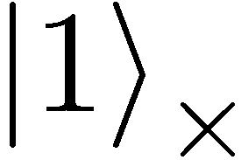
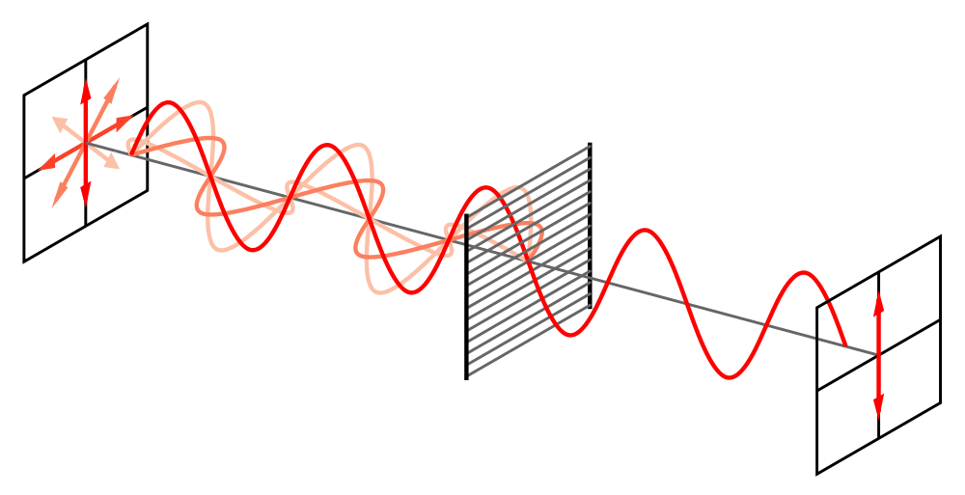
Quantum Mechanics (of Photons)
+ basis
£ basis

Slide 16
Quantum Mechanics
+ basis
£ basis
Measurements:
with prob. 1 yields 1
0/1
with prob. ½ yields 0
0/1
with prob. ½ yields 1

Slide 17
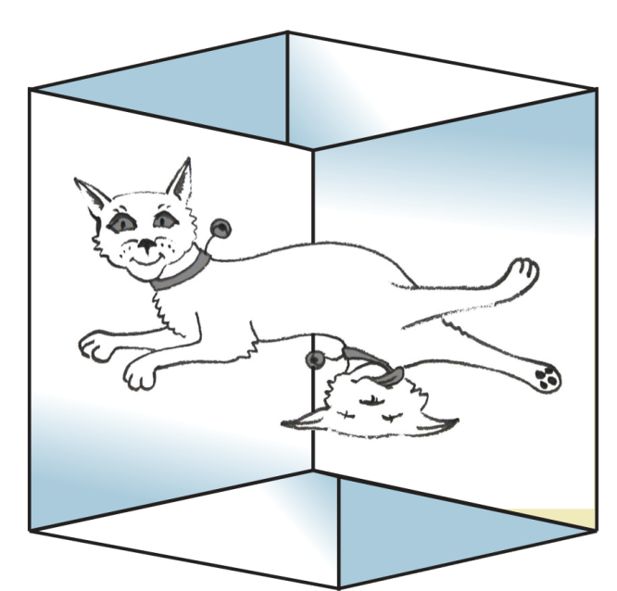
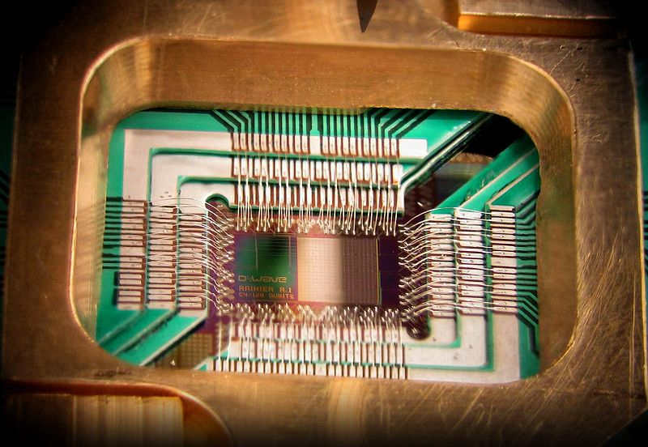

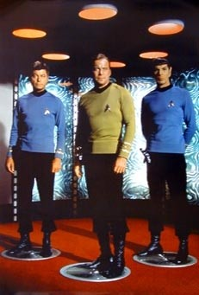
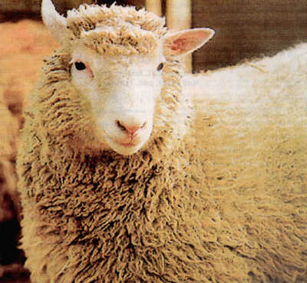
Wonderland of Quantum Mechanics

Slide 18
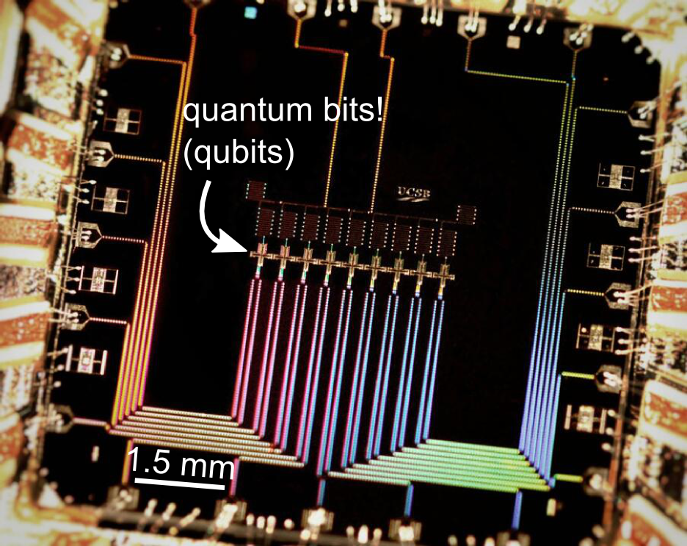
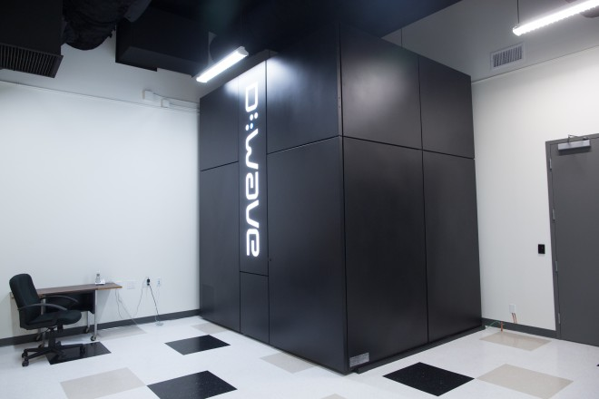

Can We Build Quantum Computers?
Possible to build in theory, no fundamental theoretical obstacles have been found yet.
Canadian company “D-Wave” claims to have build one. Did they?
2014: Martinis group “acquired” by Google
2014: 1.35 Mio € investment in QuTech centre in Delft
Martinis group (UCSB)
9 qubits

Slide 19
Demonstration of Quantum Technology
generation of random numbers
50%
50%
(diagram from idQuantique white paper)
no quantum computation, only
quantum communication required

Slide 20
No-Cloning Theorem
U
Quantum operations:
?
?
?
Proof: copying is a non-linear operation

Slide 21
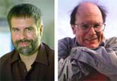
Quantum Key Distribution (QKD)
21
[Bennett Brassard 84]
Alice
Bob
k = ?
k = 0101 1011
Eve
k = 0101 1011
Offers a quantum solution to the key-exchange problem
Puts the players into the starting position to use symmetric-key cryptography (encryption, authentication etc.).

Slide 22
Quantum Key Distribution (QKD)
22
[Bennett Brassard 84]
0 1 1 1 0
0 0 1 1 0
k = 110
k = 110

Slide 23
Quantum Key Distribution (QKD)
23
[Bennett Brassard 84]
?
?
?
?
?
0 1 1 1 0
0 0 1 1 0
k = ?
k = 10
k = 10
Quantum states are unknown to Eve, she cannot copy them.
Honest players can test whether Eve interfered.

Slide 24
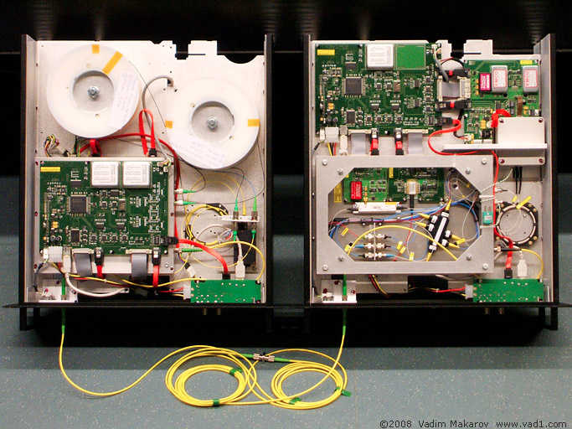

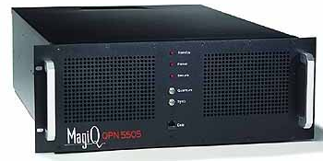
Quantum Key Distribution (QKD)
24
[Bennett Brassard 84]
Alice
Bob
Eve
technically feasible: no quantum computer required,
only quantum communication

Slide 25
What will you Learn from this Talk?
Classical Cryptography
Quantum Mechanics
Quantum Key Distribution
Position-Based Cryptography

Slide 26
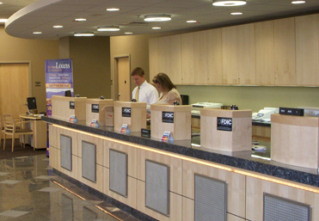
Position-Based Cryptography
Typically, cryptographic players use credentials such as
  secret information (e.g. password or secret key)
  authenticated information
  biometric features
Can the geographical location of a player be used
as cryptographic credential ?

Slide 27
Position-Based Cryptography
Can the geographical location of a player be used as sole cryptographic credential ?
Possible Applications:
  Launching-missile command comes
  from within the military headquarters
  Talking to the correct country
  Pizza-delivery problem /
  avoid fake calls to emergency services
  …

Slide 28
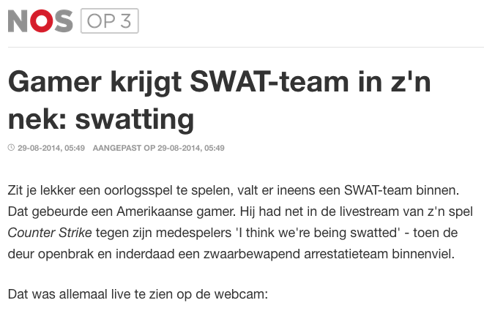
Position-Based Cryptography
http://nos.nl/op3/artikel/692138-gamer-krijgt-swatteam-in-zn-nek-swatting.html
https://youtu.be/TiW-BVPCbZk?t=117

Slide 29


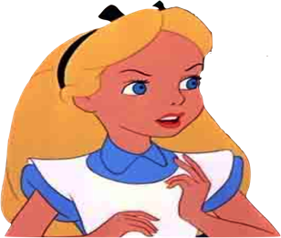

Basic task: Position Verification
Verifier1
Prover
Verifier2
Prover wants to convince verifiers that she is at a particular position
no coalition of (fake) provers, i.e. not at the claimed position, can convince verifiers
assumptions:  communication at speed of light
            instantaneous computation
            verifiers can coordinate

Slide 30




Position Verification: First Try
Verifier1
Prover
Verifier2
time
distance bounding [Brands Chaum ‘93]

Slide 31
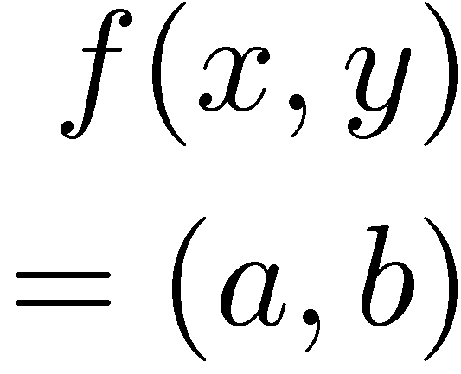


Position Verification: Second Try
Verifier1
Prover
Verifier2
position verification is classically impossible !
Notes:
classical impossibility proof by [Chandran Goyal Moriarty Ostrovsky: CRYPTO ’09]

Slide 32


The Attack
copying classical information
this is impossible quantumly

Slide 33


Position Verification: Quantum Try
[Kent Munro Spiller 03/10]
?
?
?
Can we brake the scheme now?

Slide 34




Attacking Game
?
?
?
?
?
Impossible to cheat due to non-cloning theorem
Or not?

Slide 35
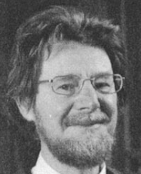
Teleportation Attack
?
?
?
[Bell]
[Bell]
?
?
It is possible to cheat with entanglement !!
Quantum teleportation allows to
break the protocol perfectly.

Slide 36
No-Go Theorem
[Buhrman, Chandran, Fehr, Gelles, Goyal, Ostrovsky, Schaffner 2010]
Any position-verification protocol can be broken using an exponential number of entangled qubits.
Question: Are so many quantum resources really necessary?
Does there exist a protocol such that:
  honest prover and verifiers are efficient, but
  any attack requires lots of entanglement

Slide 37
What Have You Learned from this Talk?
Classical Cryptography
  Long history
  One-time pad
  Public-key cryptography
m = 0000 1111
c = m © k = 0101 0100
Alice
Bob
k = ?
Eve
k = 0101 1011
k = 0101 1011

Slide 38
What Have You Learned from this Talk?
Quantum Mechanics
  Qubits
  Quantum Computer
  No-cloning
  Entanglement
  Quantum Teleportation

Slide 39
What Have You Learned from this Talk?
Quantum Key Distribution (QKD)
Position-Based Cryptography

Slide 40
Thank you for your attention!
Questions

