Slide 1
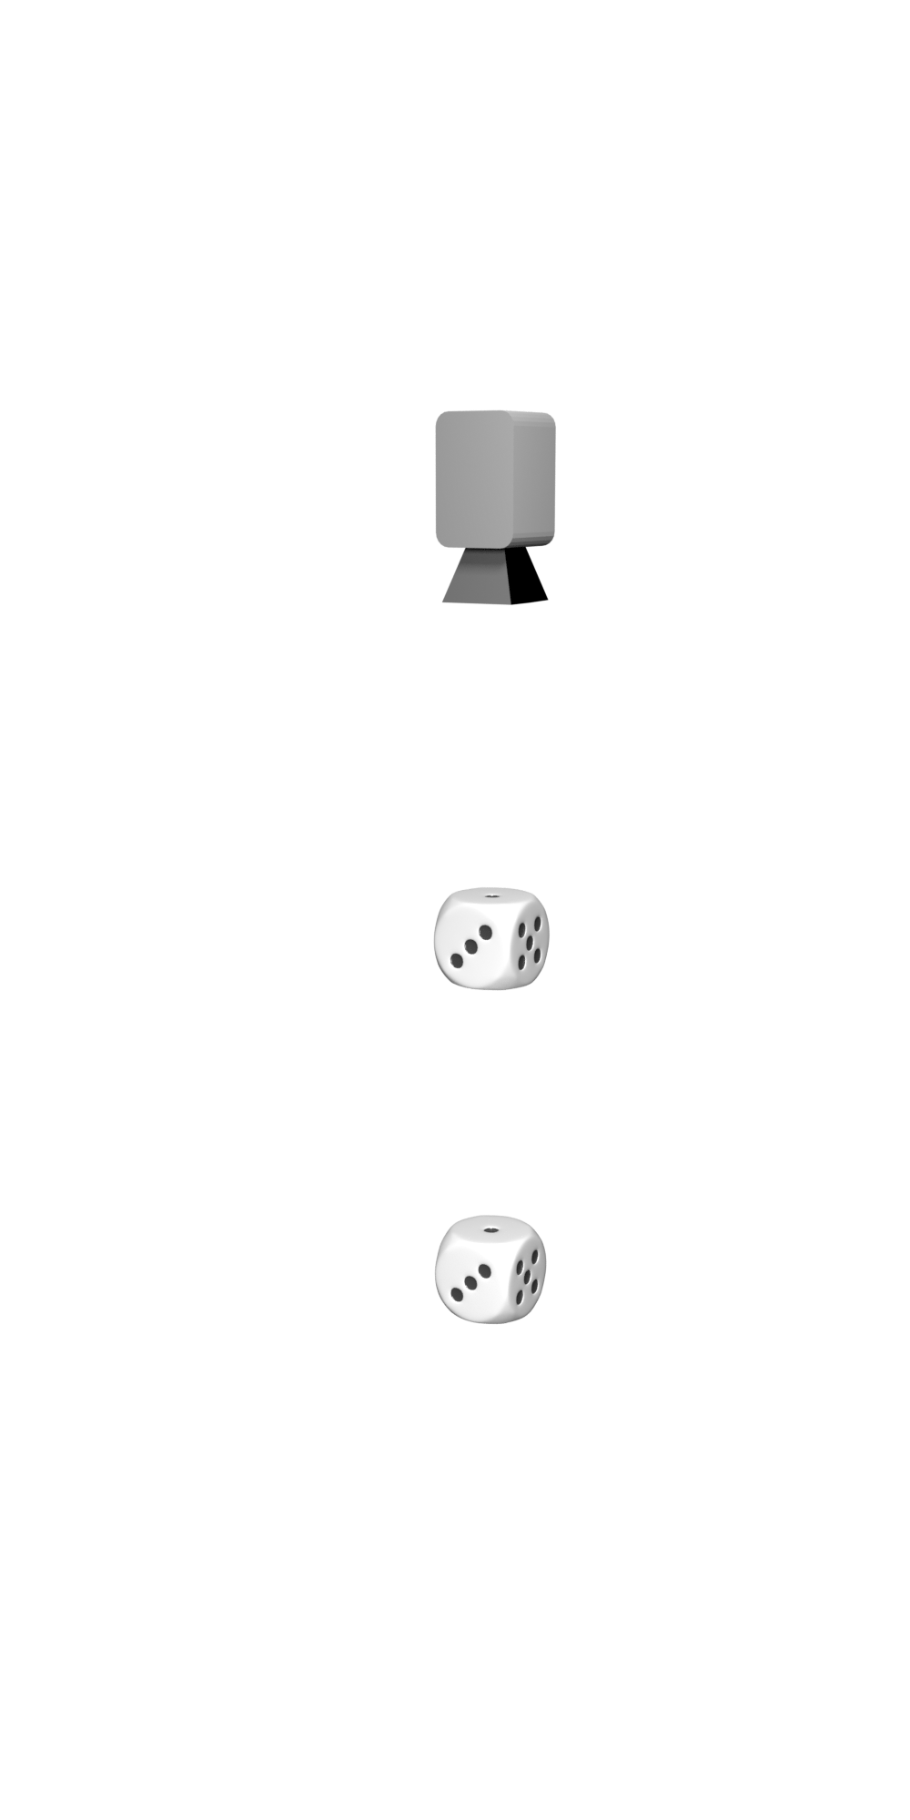
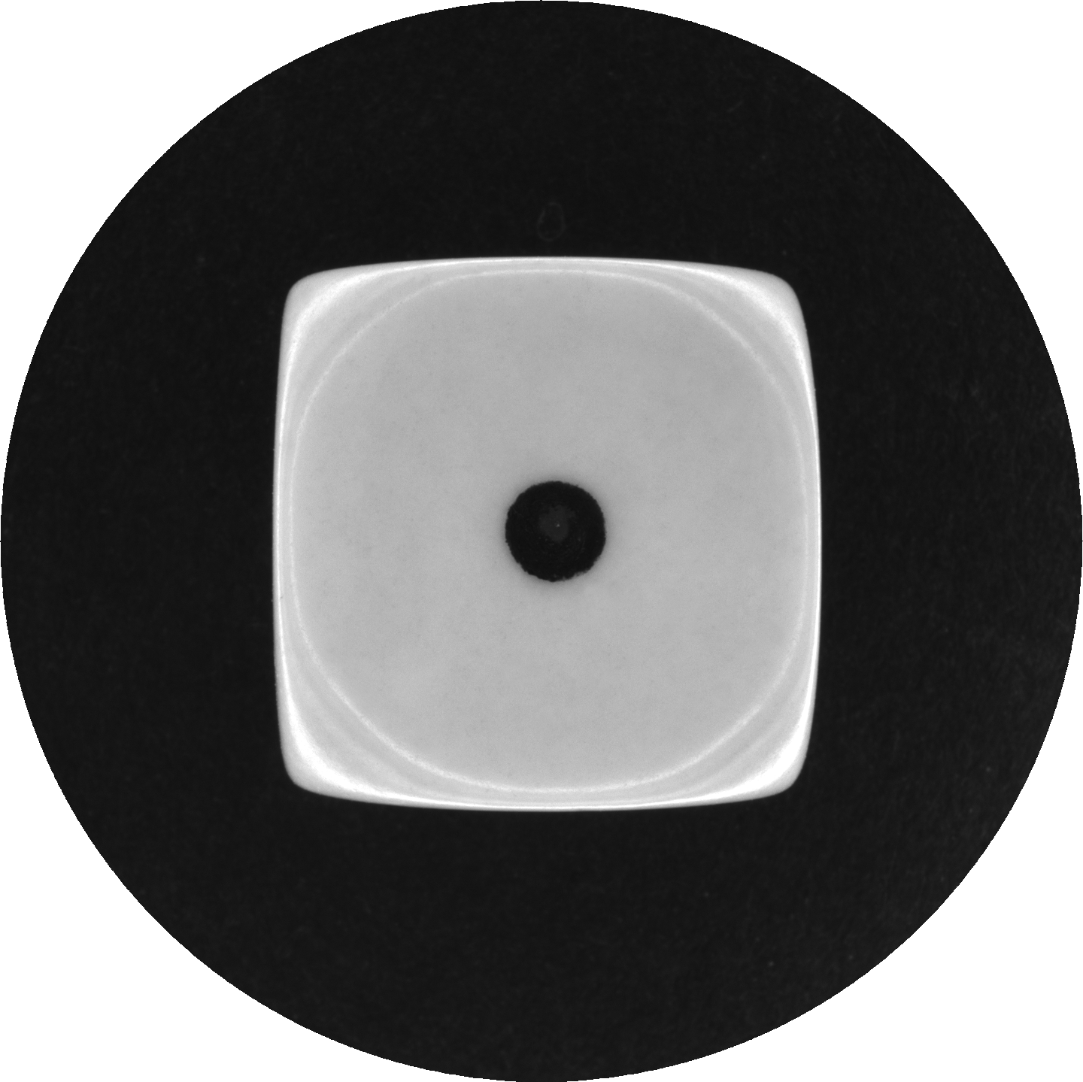
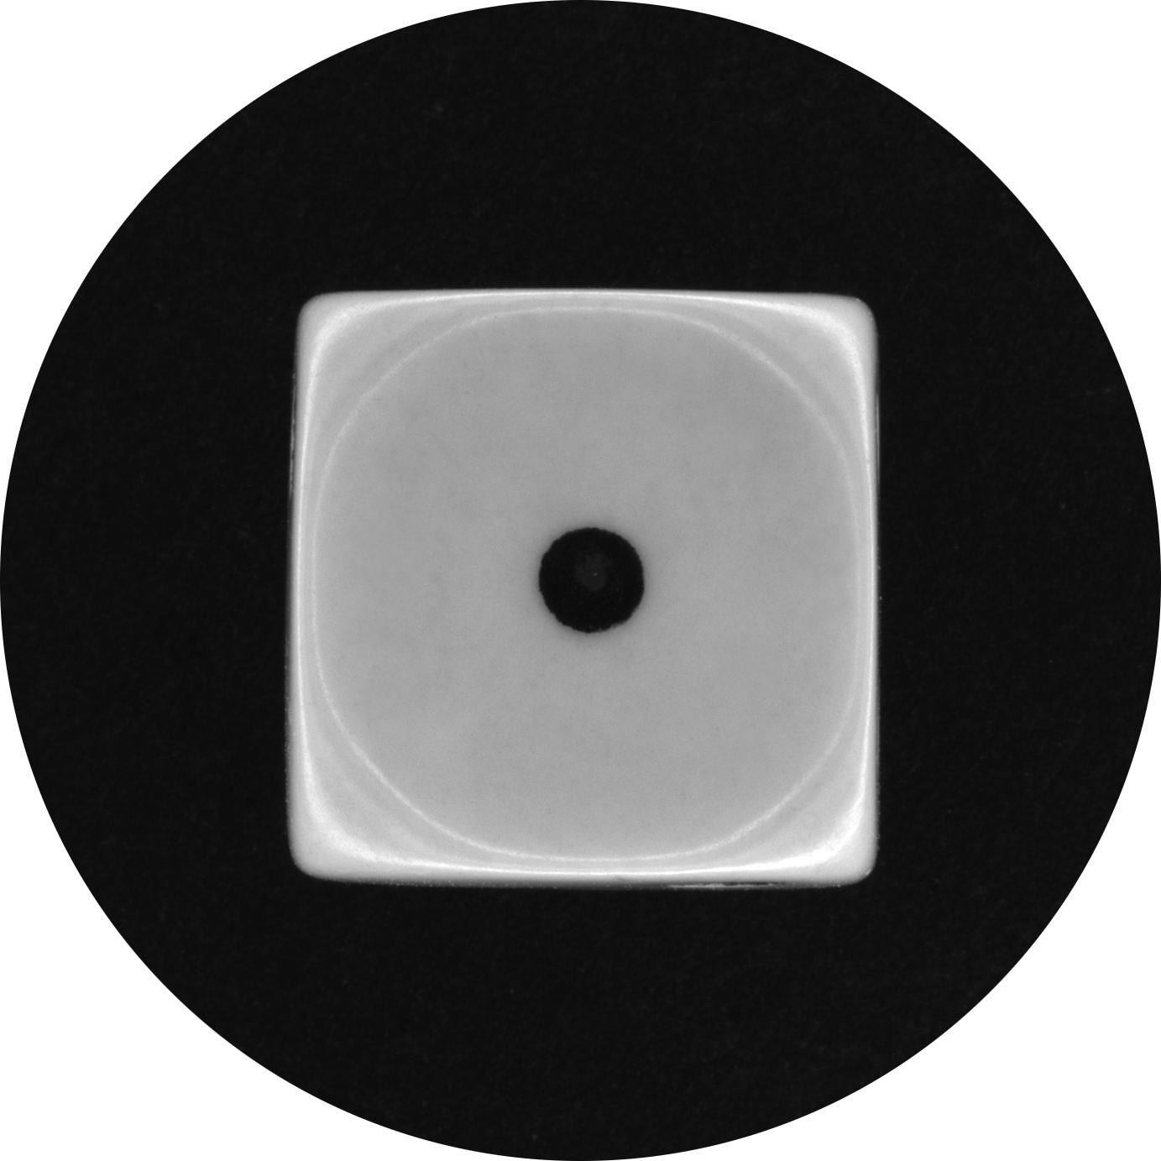
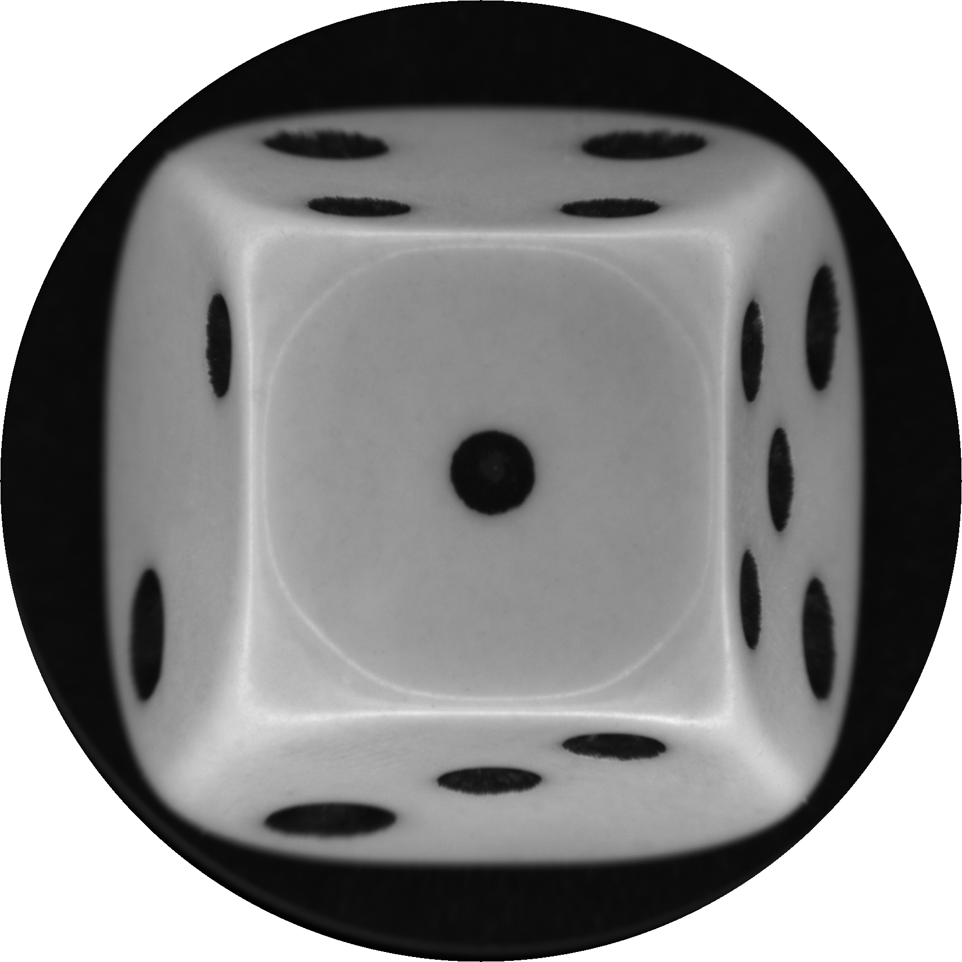
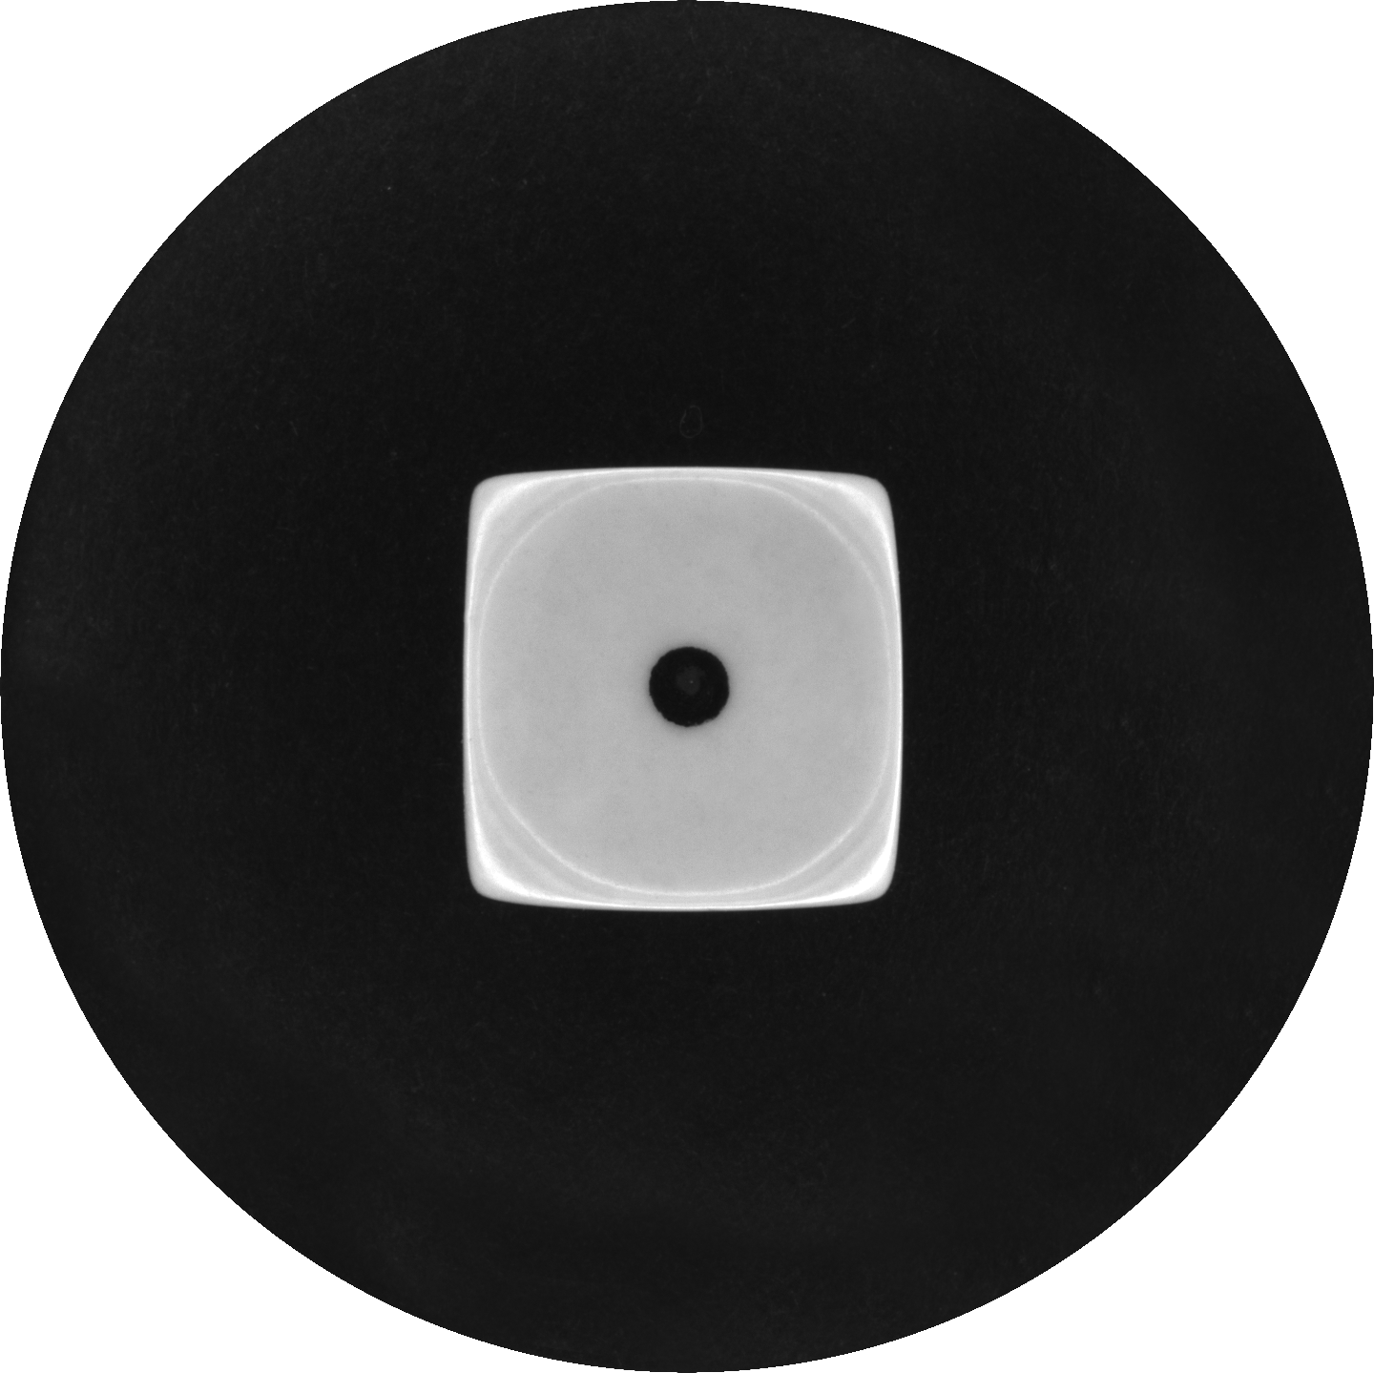
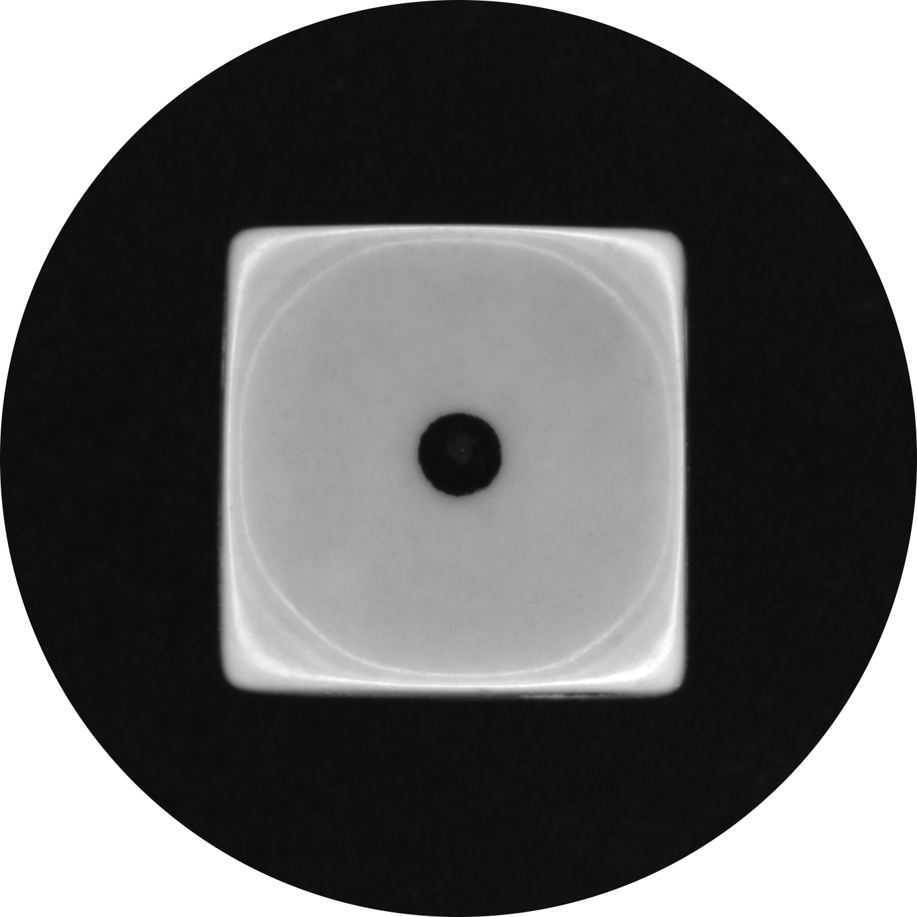
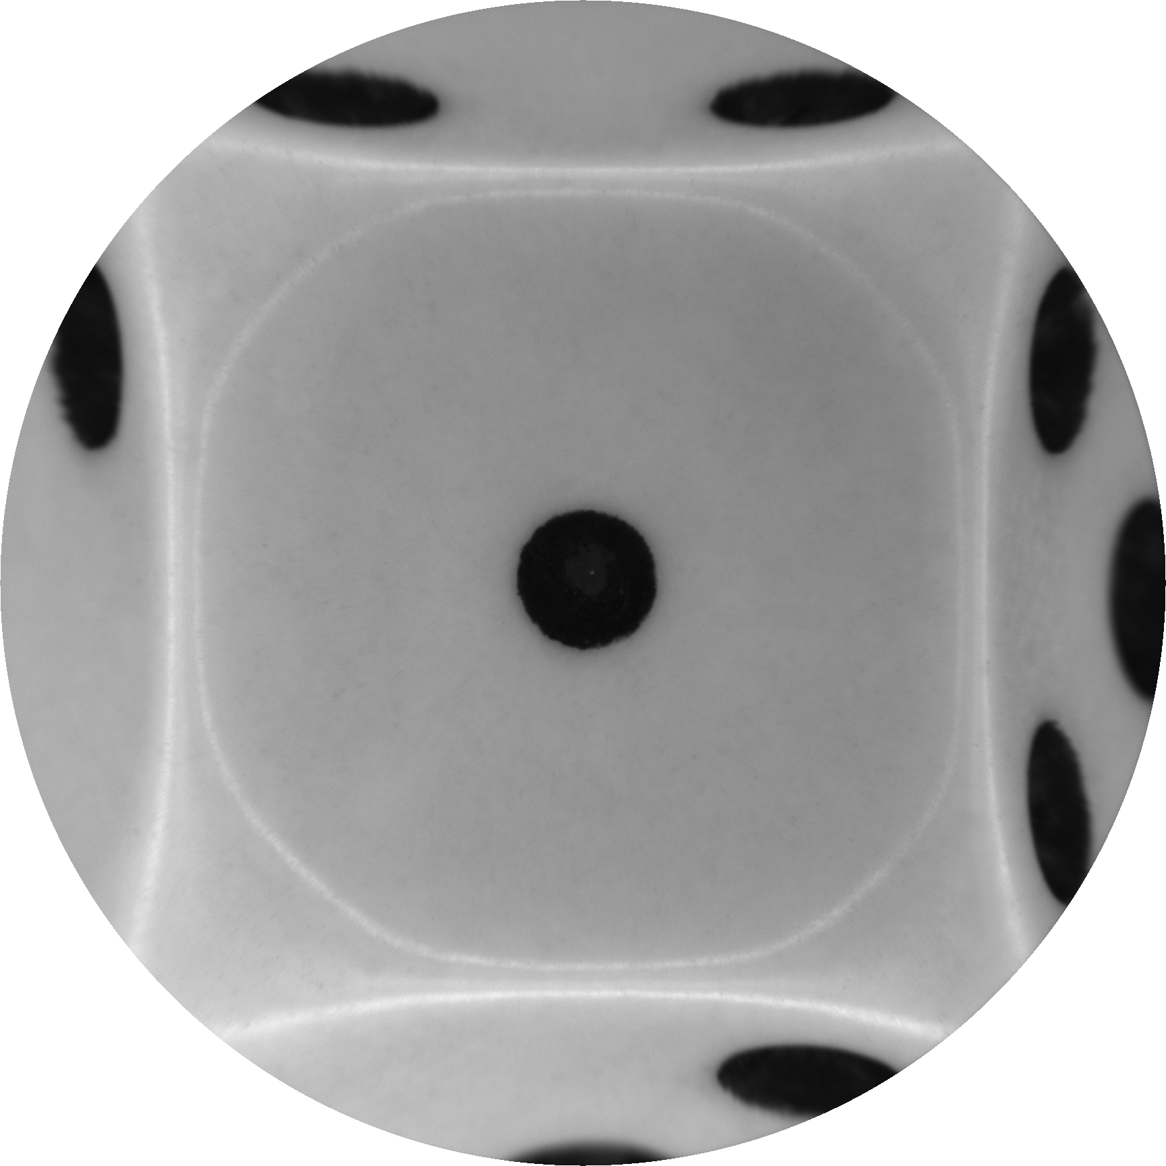



A Unifying “Anycentric” Pinhole Camera Model
for Calibrating Ento-, Tele- and Hypercentric Lenses
Entocentricity
Telecentricity
Hypercentricity
Objects are imaged smaller
with increasing distance.
Objects are imaged at the same size
regardless of the distance.
Objects are imaged larger
with increasing distance.
$$z$$
$$z_{1}$$
$$z_{2}$$
$$z_{1}<z_{2}$$

Slide 2
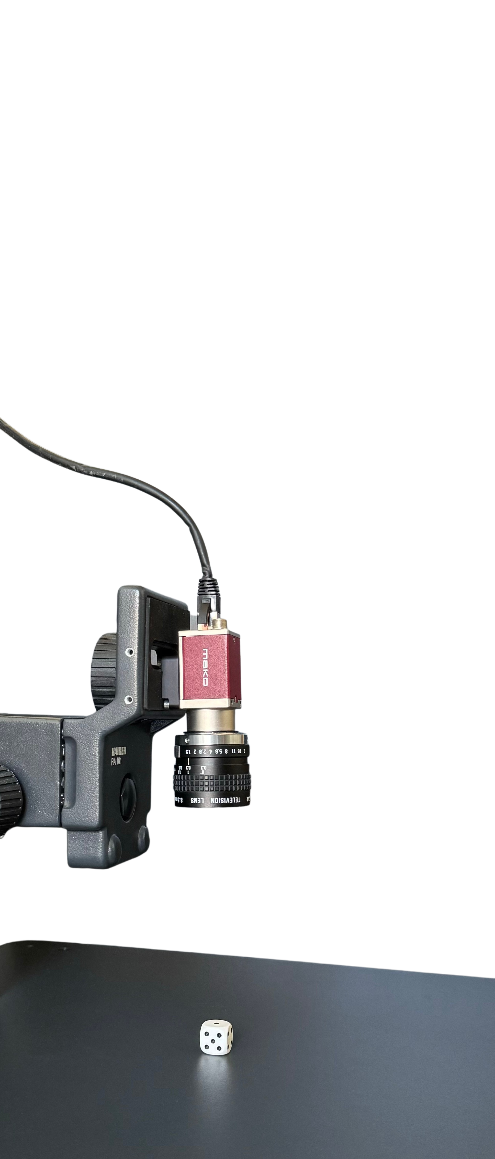
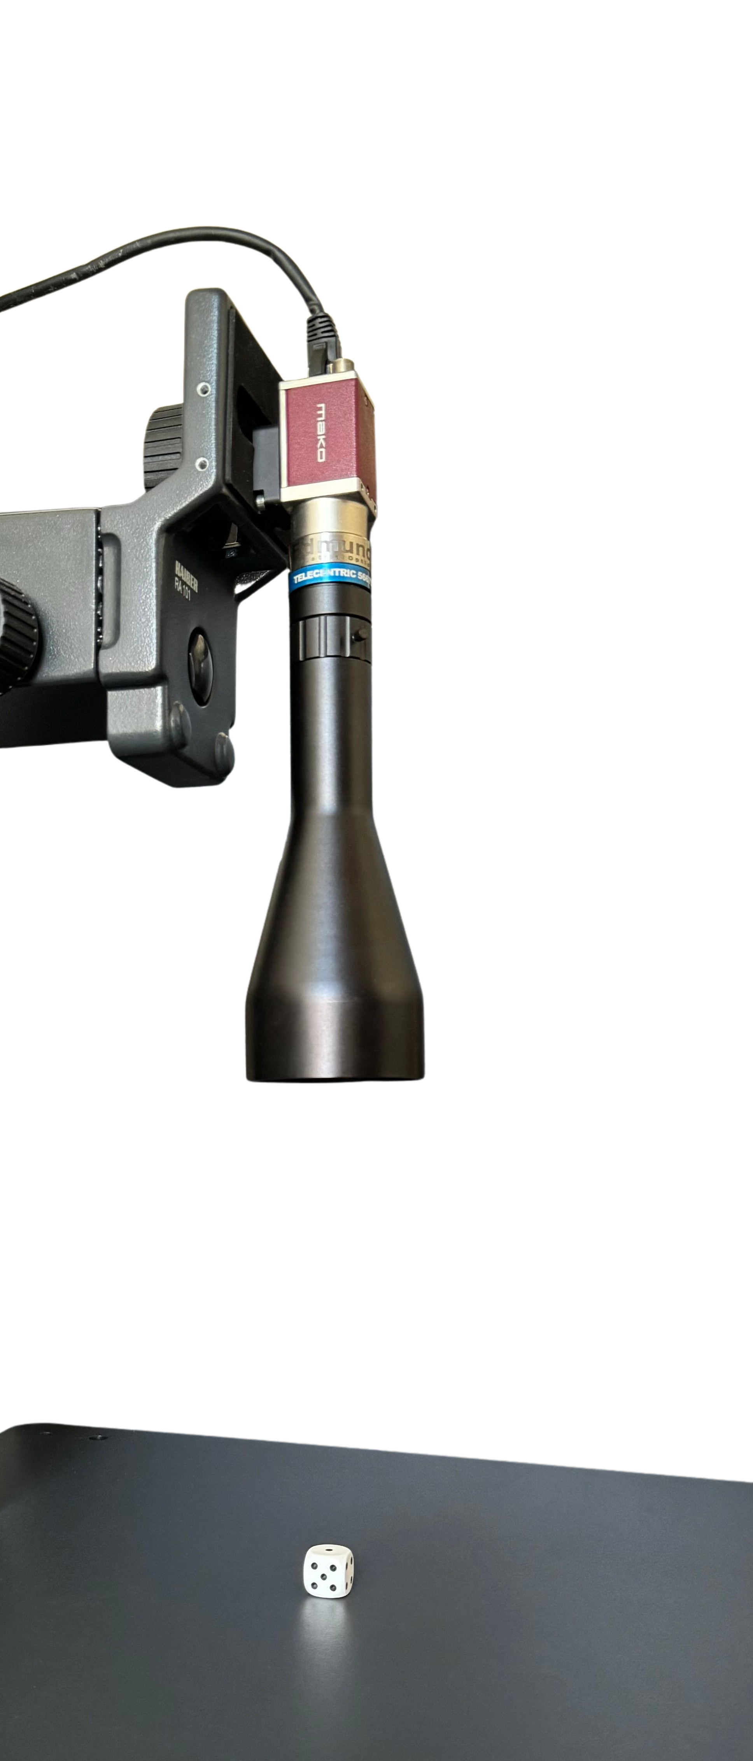
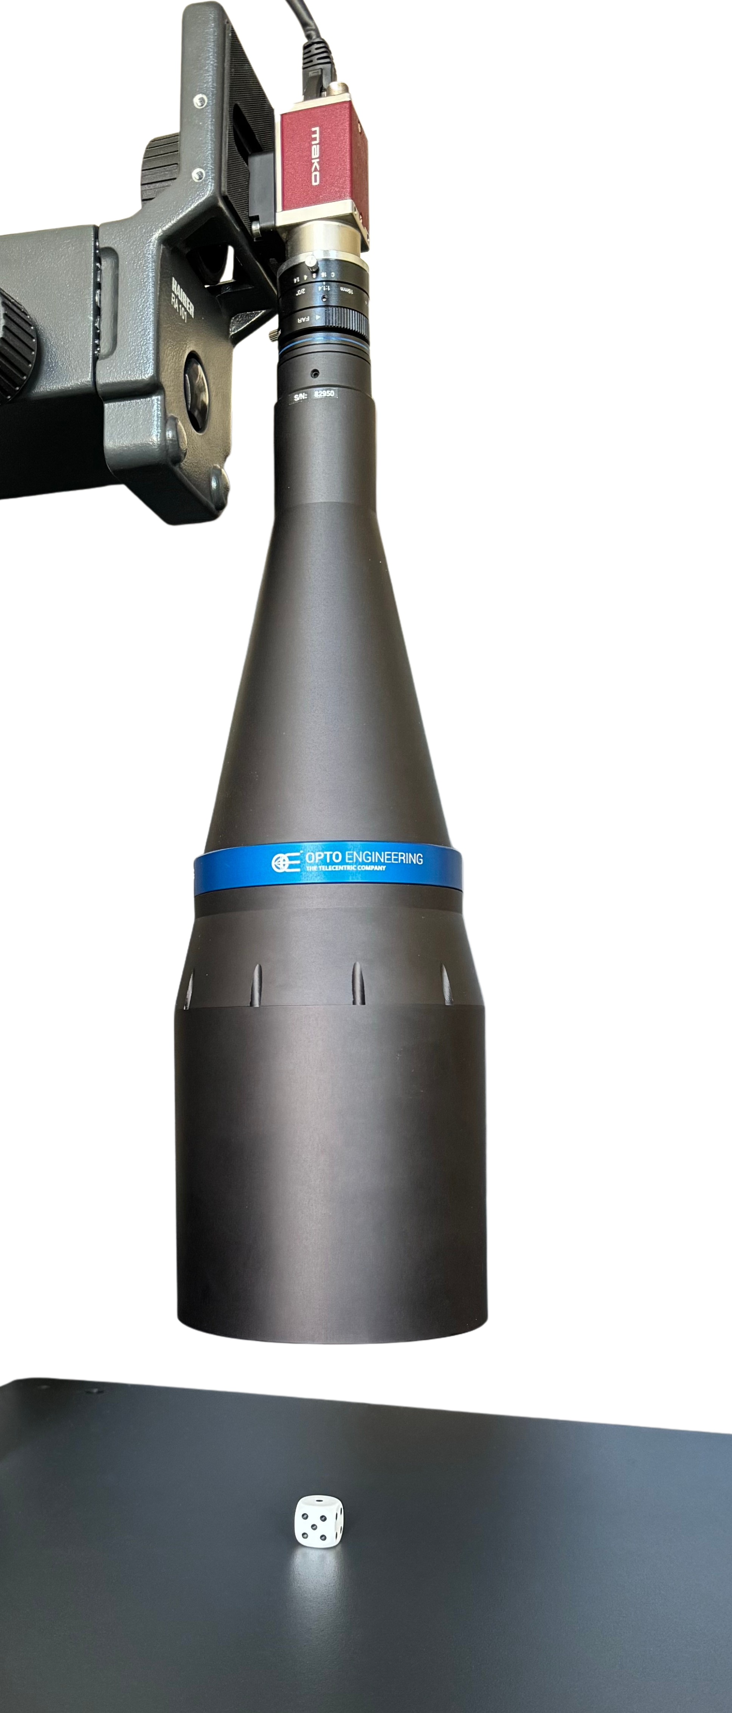
A Unifying “Anycentric” Pinhole Camera Model
for Calibrating Ento-, Tele- and Hypercentric Lenses
Entocentricity
Telecentricity
Hypercentricity

Slide 3
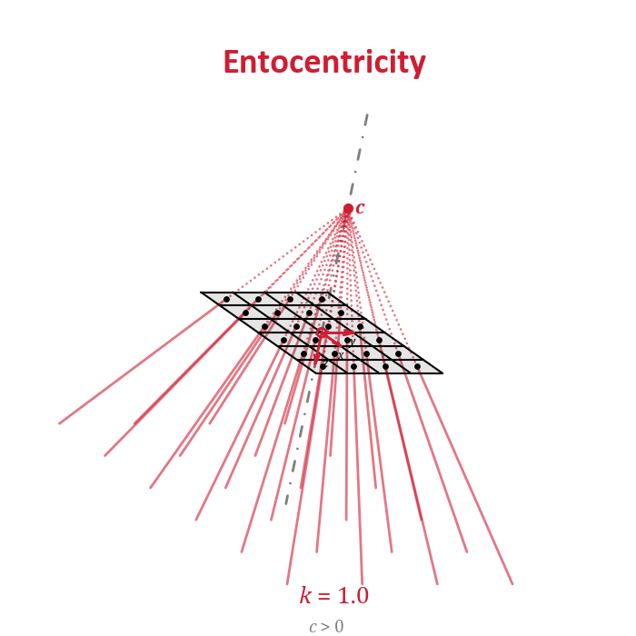

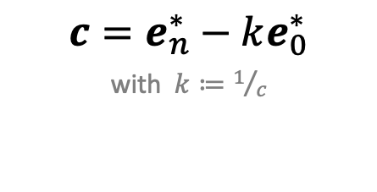



A Unifying “Anycentric” Pinhole Camera Model
for Calibrating Ento-, Tele- and Hypercentric Lenses
Plane-based Geometric Algebra
$$ℝ_{n,0,1}^{∗}$$
image
plane
Camera Center $c$
$c=e_{n}^{∗}−ke_{0}^{∗}$
with $k≔1/c$
image points
$$p$$
Chief Rays
$$c∨p$$

