Slide 1
BRINGING ENGINEERS TO GEOMETRIC ALGEBRA
(AND VICE VERSA)
Duane Storti

Slide 2
Plan for the talk
Self-introduction
Mission
Current status of GA in ME/CE & how to change it…
Reaching multiple audiences: faculty, grads, undergrads
Initial offering of intro grad class
Challenges & plan to overcome them
Technical choices: algebras & software
Meet them where they are: “ladders” of concrete examples
How you can help
Sample class materials
Motivational applications
Notes:
GA = Geometric Algebra, ME/CE = mechanical/civil engineering
Just as a long historical intro should be avoided, I will save some of the self-intro material for the end and discuss on a “time available” basis.

Slide 3
Introduction/Interests
Mechanical Engineering Professor with no ME degree BS, A&EP; MS, PhD, T&AM, Cornell University
Interests within engineering, but on fringes of ME
Nonlinear dynamics, perturbations, computer algebra
Math. Foundations of CAD (F-reps): equations to describe shapes
3D Printing/Additive Manufacturing (3DP/AM)
Hardware/materials: glass, ceramics, high-performance plastics
Design/software: High-res., multi-material, VERY large data sets
GPU-based parallel computing
Modeling & analysis based on volumetric medical imaging
Interactivity with large data sets
Efficient modeling/simulation of part behavior
Finite-differences, Material Point Method (MPM), Peridynamics
Notes:
Spell out acronyms in first bullet then skip the details and go to next slide…
A&EP = Applied & and Engineering Physics, T&AM = Theoretical & Applied Mechanics, CAD = Computer-Aided Design, GPU = Graphics processing unit

Slide 4
Lifelong learning and curriculum development
Feel the need to:
Learn new things that bring value to engineering
Share those valuable things with my students and colleagues
New things (to date) and curricular inclusion:
Computer algebra (Dynamics, Computer-Aided Engineering)
3D Printing (Computer-Aided Engineering)
GPU-based parallel computing
Intro to Applied Parallel Computing for Engineers
“CUDA for Engineers” for C++
Markdown/Jupyter notebooks for python/numba
Intro to High-Performance Simulation (python/numba/taichi)
Latest & greatest: GEOMETRIC ALGEBRA

Slide 5
What am I trying to do?
Incorporate GA into engineering teaching & research
My focus is on mechanical and civil engineers who share a focus on classical mechanics
Kudos to Joan Lazenby, Peter Joot, and others who are already reaching out to other parts of the engineering community!

Slide 6
Why introduce GA?
Unified, coordinate-free, dimension-agnostic approach offers significant advantages across the curriculum:
Statics
Kinematics & Dynamics
Systems modeling/simulation/control
Robotics
Additional benefits (outside traditional curriculum):
Optics/image registration
Machine learning
Notes:
Some simplest things: Early in statics, learn to identify 2-force and 3-force members and ask how the forces musts be applied to produce equilibrium.
2-force member is pretty easy: Given one force, the other must be equal & opposite (so net force is zero); also need to enforce zero net moment to determine the forces must be colinear.
3-force member: Third force must act through intersection point of the other 2 (for zero net moment/torque), break other two forces into components; sum & negate…
With GA, both of these problems involve simple subtraction of forque (foment) bivectors.

Slide 7
Given the benefits, why has GA not yet been incorporated?
Lack of exposure:1.5 yr. search turned up 2 GA “users”:
1 post-doc: Biplane fluoroscopy (registration, not yet optim.)
1 colleague: Control of atomic force microscope
Textual Inertia
Textbooks for core courses can be VERY slow to change
Dynamics text used today looks very much like the book I used as a TA decades ago (but with color figures)
“Traditional” matrix/vector algebra took decades (~1950s)
Cognitive inertia: Colleagues are “matrix/vector” fluent
Feel like they can do whatever they need to do
Old dogs/new tricks: Can’t/won’t justify the time/effort to learn a new approach even if they could gain significant advantages
Challenging to offer new course/material without established text

Slide 8
Window of opportunity!?
Current hot topics all benefit from GA
Machine learning
Biomedical imaging
Robotics
Wave of new hires with new interests (& less inertia)
Need for practical compute-oriented experiences
Acceptance of/preference for e-books
Enables efficient creating/testing of course materials
Reduces textual inertia?

Slide 9
GA Mission involves reaching Multiple Audiences: Faculty, Grad students, Undergrads
Limited time; need to work GA intro into their schedule
Department seminar (~1 hour)
Show off capabilities
Convince faculty that their research would benefit from having students spend the time/effort to learn GA
To maintain faculty attention on a topic, have one of their students deal with that topic on an ongoing basis
Open with Arthur C. Clarke style “magic”: Dimension agnosticism
Give enough background to make the “magic” plausible
Very simple examples “by hand”
Illustrate computer handling details (avoid heavy bookkeeping)

Slide 10
Reaching Multiple Audiences: Faculty, Grad students, Undergrads
Likely most receptive audience
Seen enough matrix/vector algebra to appreciate alternatives
Not yet set in their ways
Looking to learn new things (especially with computing focus)
Multi-front approach
Department seminar to interest grads and their advisors
Short intro in related courses:
Numerical methods, High-performance simulation
Raise awareness among student population
Develop initial materials & hone GA pitch
Offer dedicated GA course at intro grad level (in 2 weeks)

Slide 11
Reaching Multiple Audiences: Faculty, Grad students, Undergrads
Ultimate target audience
Teach students to do things the efficient way the first time
Statics & Dynamics (usu. at sophomore level – 2nd year)
Avoid un-learning and re-thinking
Build solid foundation for upper-level courses
Kinematics and mechanism design
Advanced dynamics
Robotics
Will need major effort to create course materials/text
More on this in the future…
Back to immediate focus on Graduate Course

Slide 12
Intro grad course: What are the challenges?
Need for custom-focused course materials adapted to expected student background
Many are novice coders
Few, if any, have seen homogeneous coordinates: Need to introduce projective concepts from scratch
Few have graphics experience (besides playing video games)
Most are uncomfortable with the language of serious math
No experience with proofs & want to keep it that way…
No experience with differential geometry or wedge products
Limited time in a 10-week course
“Meet them where they are”: need concrete/familiar examples
Notes:
Some are also not comfortable with English…

Slide 13
Plan for overcoming the challenges
Candidate “magic” tricks (coming next)
Show examples constructed with the computing tools to be used by students in the course
“Meet the students where they are”
Start with familiar things
Recap traditional methods
Simple examples with graphical renderings
Hands-on experience instead of proofs whenever possible
Choose appropriate math/computing tools

Slide 14
“Kinemagics”

Slide 15
“Magically” Dimension-Agnostic Dynamics

Slide 16
Technical choices: Algebras to cover
Cover:
2D Euclidean (EGA2D): Most familiar; Convenient for graphics
2D Plane-based/Projective (PGA2D)
1-up model
Need to present:
Projective geometry & Duality
Representation of planes, line, points as vectors, bi-vectors, tri-vectors
Simplest algebra to include rotation & translation in the plane
Computing cost competitive with “standard” matrix/vector methods
Use PGA3D graphics to visualize embedded projective plane
3D Plane-based/projective (PGA3D):
Fully supports full classical kinematics/dynamics
Mention: Conformal GA, space-time algebra
Notes:
Note that EGA is NOT listed as supported for built-in graphics in ganja.js, kingdon.py, so tricks are needed…
CGA: stretch for interpreting vectors, Computational cost of larger basis
STA: Make students aware of applications in physics……

Slide 17
Technical choices: Computing tools
Ganja vs kingdon vs Clifford vs pygae vs GAViewer
Desire for numeric & symbolic capabilities
Departmental choice of python
Personal experience with Mma…
Interactivity: Jupyter notebooks
For this initial class: Jupyter notebook with kingdon.py

Slide 18
How you can support the effort to spread the word:
Create example “ladders” for climbing learning curve
Start from simplest, then add features
Remember the perspective of someone who does not yet know what you know about GA
Provide text to explain and point out salient features
What widgets to manipulate? What outcome should be observed?
Example: dynamics
Intro dynamics classes may barely get to 3D rigid body motion
Connect with simpler examples:
Particle dynamics (Explicitly describe inverse momentum operator)
Start with 1D and work up to 2D and 3D
Simple, familiar constraints: (double) pendulum (planar, spherical)
More advanced topics
Lagrangian mechanics (generalized coords – or lack thereof)
Multi-domain systems: electromechanical systems (Williams)
Save historical discussions until the end…
Notes:
Engage a student to draft the textual explanations!?
Fundamentals of Applied Dynamics, J. H. Williams, MIT

Slide 19
Examples of course materials
“Magic” examples (in kingdom or ganja - seen earlier)
Show Mathematica examples
Show conversion to Kingdon
Illustrate native graphic interactivity and widgets

Slide 20
Interactive Graphics using Mathematica

Slide 21
Interactive Graphics using kindon.py
Projective duality (2D & 3D)

Slide 22
Code for kingdon duality interactive demo
%pip install -q kingdon anywidget==0.9.9
import numpy as np
from kingdon import Algebra
import ipywidgets
EGA2D = Algebra(2, 0, 0)
PGA2D = Algebra(2, 0, 1)
PGA3D = Algebra(3, 0, 1)
line2 = lambda x, y: PGA2D.vector(e0=1, e1=x, e2=y)
point2 = lambda x, y: line2(x,y).dual()
plane3 = lambda x, y, z: PGA3D.vector(e0=1, e1=x, e2=y,
e3=z)
point3 = lambda x, y, z: plane3(x, y, z).dual()
# embed 2d points into 3D space
def up(U):
u1 = U.e01
u2 = U.e02
return point3(u2, 1, u1)
# Embed EGA2D objects in PGA2D (for 2D visualization)
# z=1 for standard embedding in projective plane
# z=0 restricts planes to pass through origin as in EGA2D
def embed(U,z):
x1 = U.e1
x2 = U.e2
return PGA2D.vector(e0=z, e1=x1, e2=x2)
def down(U):
x1 = U.e01
x2 = U.e02
return EGA2D.vector(e1=x1, e2=x2)
U = point2(1., 0.5)
def graph_func2():
O = point2(0,0)
Uline = U.dual()
Vline = V.dual()
X = point2(1,0)
Y = point2(0,1)
xaxis = [O,X]
yaxis = [O,Y]
return [
gray, O, 'O', xaxis, 'X’,
yaxis, 'Y’,
red, U, 'U', [O,U],
red, Uline,]
graph2 = PGA2D.graph(
graph_func2,
animate=True,
width='100%',
scale=1.0,
pointRadius=3,
lineWidth=10,
grid=True,
fontSize=2)
def graph_func3():
s = 1.5
P3 = point3(0,0,0)
O3 = up(O)
U3 = up(U)
X3 = up(point2(1,0))
Y3 = up(point2(0,1))
xaxis = [O3,X3]
yaxis = [O3,Y3]
projPlane = s * PGA3D.vector(e0=-1, e1=0, e2=1, e3=0)
ULine3 = s * U3 & P3
UPlane3 = s * (U3.dual() | P3)*P3
ULine2 = UPlane3 ^ projPlane
return [cyan, xaxis, 'x1', magenta, yaxis, 'x2',
black, P3, 'P', O3, 'O', P3&O3,
gray, projPlane,
red, U3, 'U', ULine2,
0x882222, ULine3, UPlane3, ]
graph3 = PGA3D.graph(
graph_func3,
animate=True, width='100%',
scale=1.0, pointRadius=3,
lineWidth=10, grid=True, fontSize=3,)
ipywidgets.VBox([graph2, graph3])

Slide 23
Interactive Graphics using kingdon.py
PGA2D: Transformations as bireflections

Slide 24
Kingdon code for transformations graphic
%pip install -q kingdon anywidget==0.9.9
import numpy as np
from kingdon import Algebra
import ipywidgets
EGA2D = Algebra(2, 0, 0)
PGA2D = Algebra(2, 0, 1)
PGA3D = Algebra(3, 0, 1)
line2 = lambda x, y: PGA2D.vector(e0=1, e1=x, e2=y)
point2 = lambda x, y: line2(x,y).dual()
plane3 = lambda x, y, z: PGA3D.vector(e0=1, e1=x, e2=y, e3=z)
point3 = lambda x, y, z: plane3(x, y, z).dual()
# embed 2d points into 3D space
def up(U):
u1 = U.e01
u2 = U.e02
return point3(u2, 1, u1)
# Embed EGA2D objects in PGA2D (for 2D visualization)
# z=1 for standard embedding in projective plane
# z=0 to restrict hyperplanes to pass through origin as in EGA2D
def embed(U,z):
x1 = U.e1
x2 = U.e2
return PGA2D.vector(e0=z, e1=x1, e2=x2)
def down(U):
x1 = U.e01
x2 = U.e02
return EGA2D.vector(e1=x1, e2=x2)
U = point2(1., 0.5)
V = point2(1.5, 1.75)
W = point2(-0.25, 0.75)
B1 = point2(1,1)
B2 = point2(2,1)
B3 = point2(2,2)
def sandwich_graph_func():
O = point2(0,0)
E1 = point2(2,0)
E2 = point2(0,2)
ULine = embed(U.dual(), 0)
VLine = embed(V.dual(), 0)
WLine = embed(W.dual(), 0)
VUVLine = (VLine*ULine*VLine)/(VLine|VLine)
VUV = point2(-(VUVLine.dual()).e02, (VUVLine.dual()).e01 )
XLine = (WLine*VUVLine*WLine)/(WLine|WLine)
X = point2(-(XLine.dual()).e02, (XLine.dual()).e01 )
UColor = black
VColor = red
WColor = cyan
VUVColor = magenta
XColor = blue
R = V.dual()*U.dual()
return [ O, 'O', O&E1, 'x1', O&E2, 'x2',
UColor, U, U.dual(), VColor, V, V.dual(),
green, [B1,B2,B3],
blue, [R>>B1,R>>B2,R>>B3],]
PGA2D.graph(sandwich_graph_func, grid=True, pointRadius=2, animate=True, fontSize=2, lineWidth=4, aspect='equal')

Slide 25
Applications of personal interest
F-rep CAD
Additive manufacturing/3D printing
Bi-plane fluoroscopy for gait analysis

Slide 26
Function-based representations (F-reps):
We recognize f(x,y,z) = x² + y² + z² -1 < 0 as a sphere. What about expressions for more interesting shapes?
Notes:
Applications I have dealt with that make me appreciate the potential of GA (as time allows…)

Slide 27
Function-based representations (F-reps):
We recognize f(x,y,z) = x² + y² +z² < 1 as a sphere. What about expressions for more interesting shapes?

Slide 28
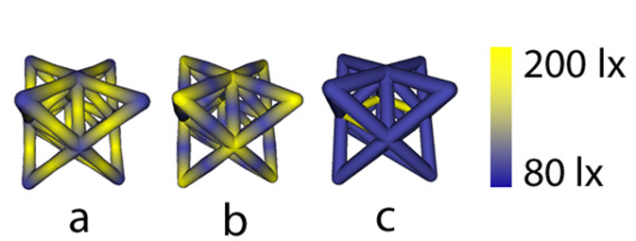
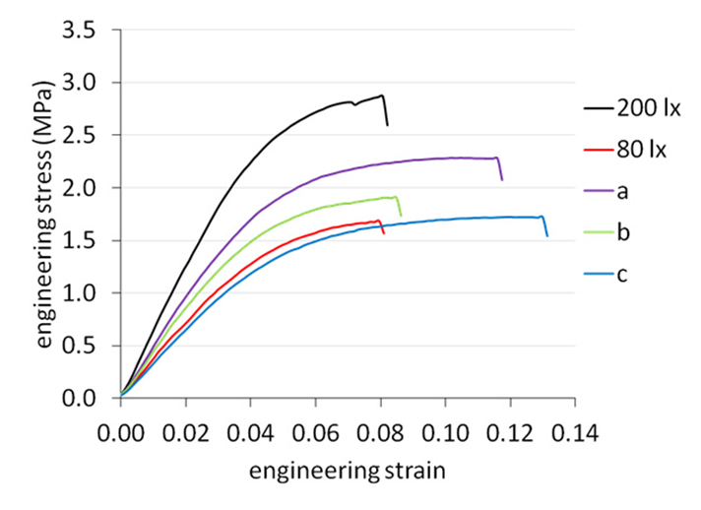
3D Printing with local property control

Slide 29
Biplane Fluoroscopy

Slide 30
Conclusion, Thanks, and Questions…
Thanks to the organizers and reviewers.
Thank you for your attention.
Happy to take questions now or discuss later…

