Slide 1
APPLICATIONS OF GEOMETRIC ALGEBRA IN SURVEYING AND GEODESY
The Resection Problem
B
A
C
$$α$$
$$β$$
Jorge Ventura, Fernando Martínez, Ahmad h. Eid, Francisco Manzano-Agugliaro, Jaroslav Hrdina, Aleš Návrat, Francisco G. Montoya
O
P

Slide 2
The Resection Problem
B
Three known points A, B and C (beacons)
A
C
Relative angular measurements α and β from P
$$α$$
$$β$$
O
P
Unknown point P (station)

Slide 3
Applications
Geodesy
Navigation
Computer
Graphics
Robot Path
Planning

Slide 4
Applications
Navigation
Computer
Graphics
Robot Path
Planning
Geodesy

Slide 5
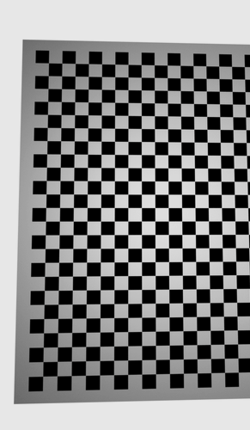
Applications
Geodesy
Computer
Graphics
Robot Path
Planning
Navigation

Slide 6
Applications
Geodesy
Navigation
Robot Path
Planning
Computer
Graphics

Slide 7
Applications
Geodesy
Navigation
Computer
Graphics
Robot Path
Planning

Slide 8
Trigonometric
Tradicional
Methods
Traditionally, solutions to this problem have relied on heavily algebraically loaded methods, which can be complex and challenging to comprehend.

Slide 9
Geometric
Trigonometric
Tradicional
Methods
Trigonometric methods are some of the oldest and most famous procedures for solving the 2D resection problem. They are based on the use of trigonometric functions to compute the position of the observer using the angles between the known points and the observer
Snellius
Kaestner-Burkhardt
Madsen and Andersen
Easton and Cameron
Cassini

Slide 10
Geometric
Iterative
Trigonometric
Tradicional
Methods
Geometric methods use geometrical constructions and properties of the known points to calculate the position of the observer. These methods are based on the use of geometric and graphic principles to solve the problem.
Collins
McGillem
Cohen and Koss
Esteves et al.
Tsukiyama
Font-Llagunes
Ligas
Pierlot et al.
Cassini

Slide 11
Others
Geometric
Iterative
Tradicional
Methods
Iterative methods use iterative algorithms to converge to the observer position. These methods are based on the use of an initial estimate of the observer position, which is refined iteratively until convergence is achieved.
Sanchiz et al.
Dekov

Slide 12
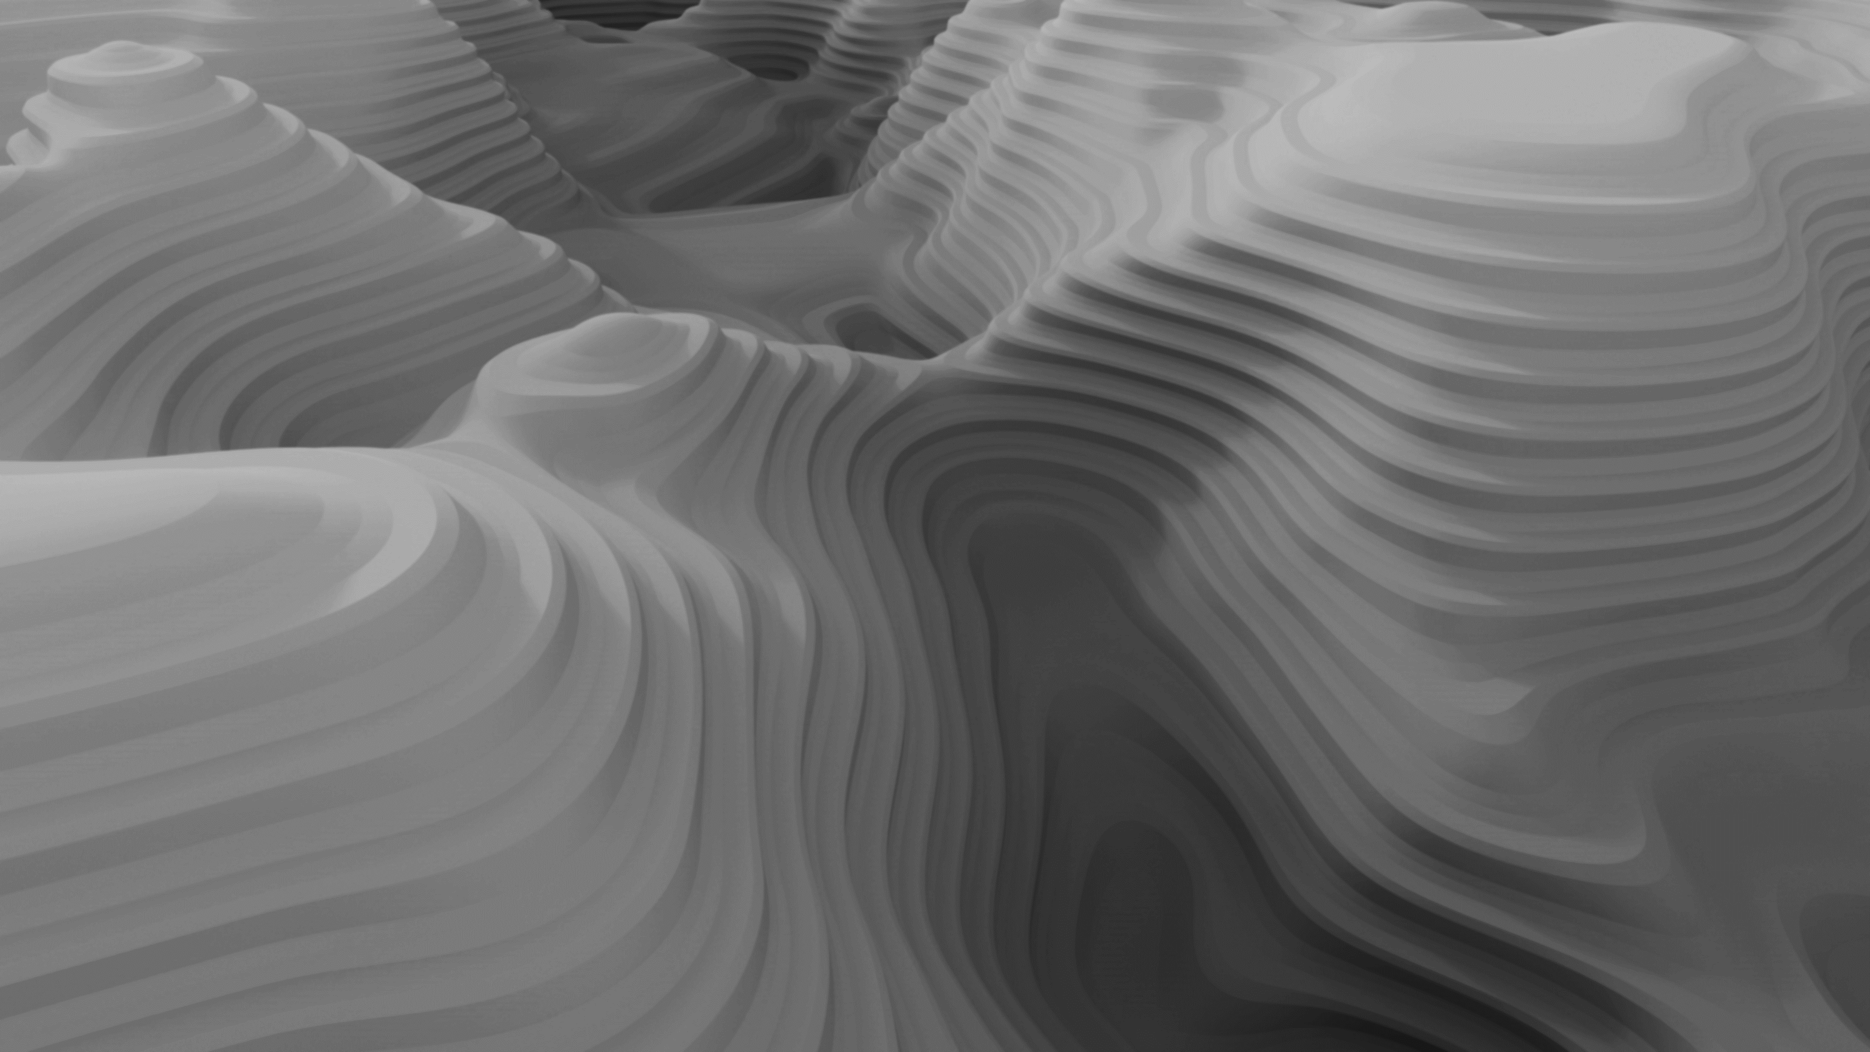
Resection using Geometric Algebra
Iterative
Others
Vector GA Method
$$e^{iθ}$$
Cassini Construction
Tradicional
Methods
There are other methods that do not fit in with the above. For example, based on barycentric coordinates, complex numbers or graphical methods.
Collins Construction
Collins
Willerding
Tienstra

Slide 13
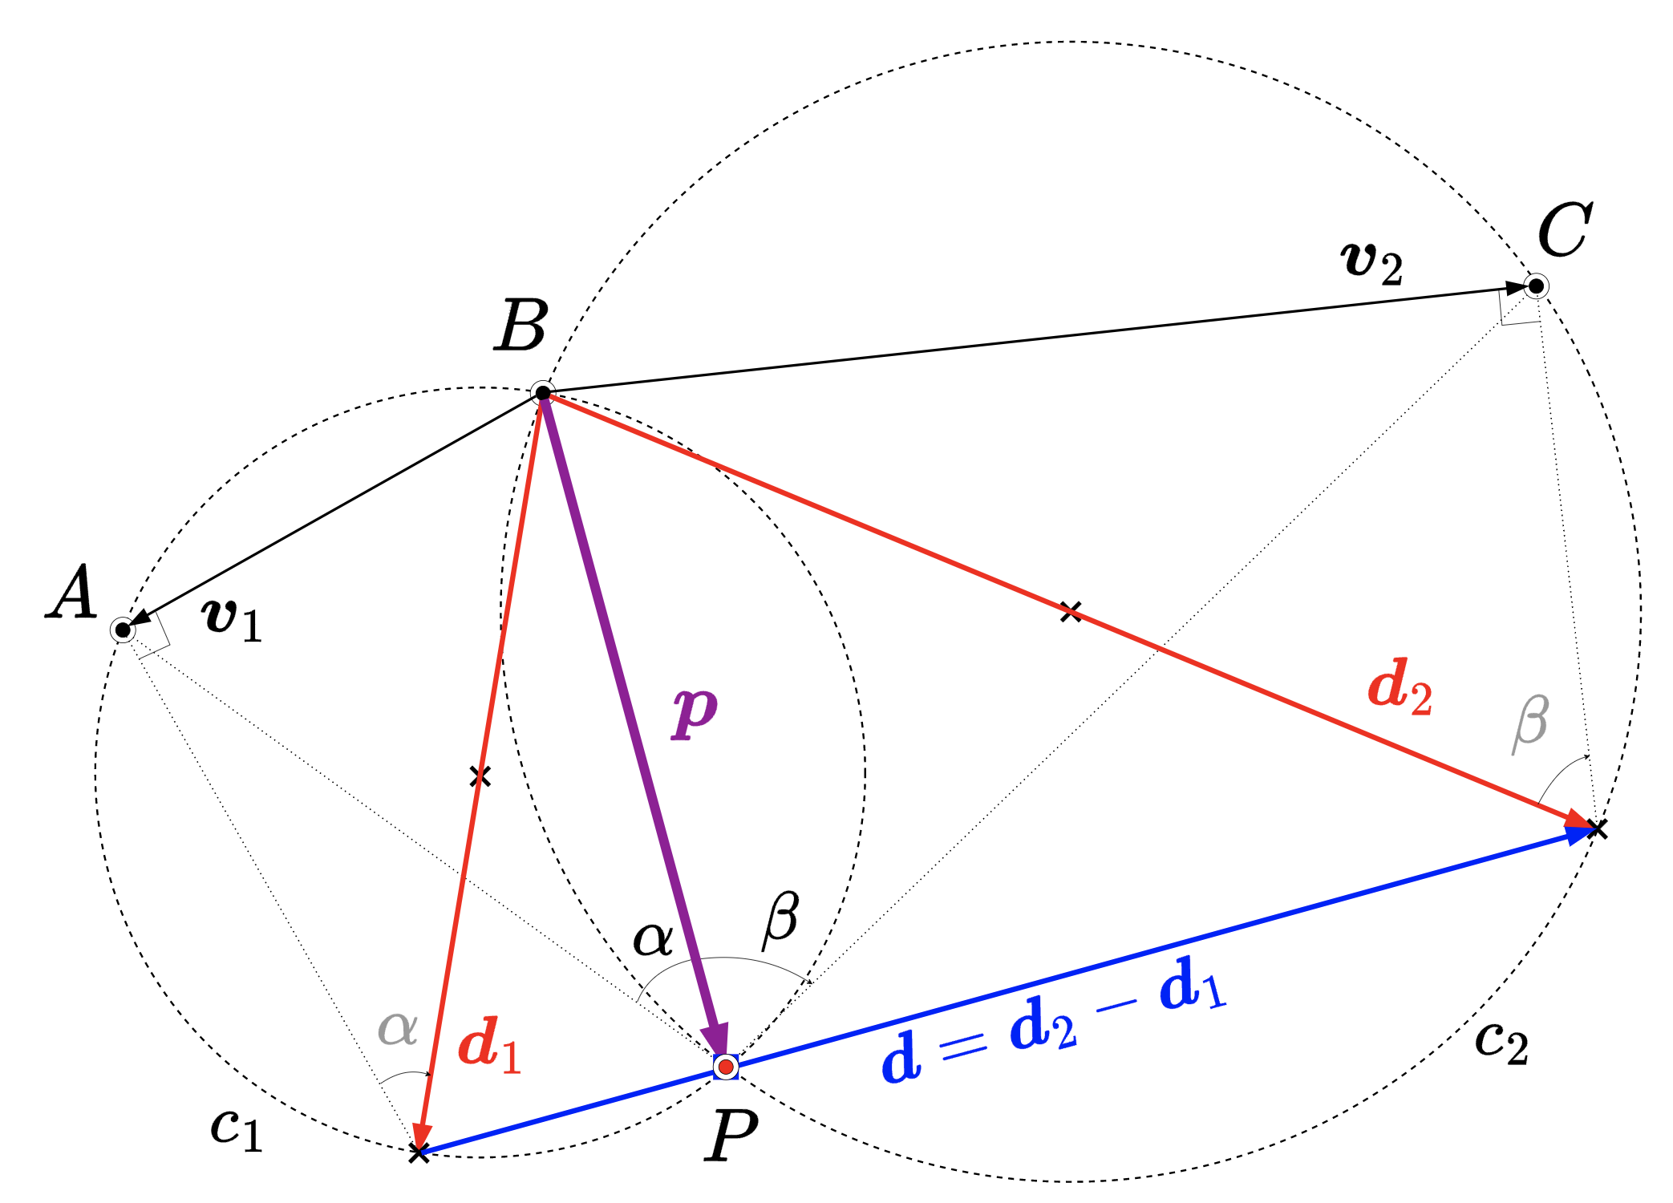
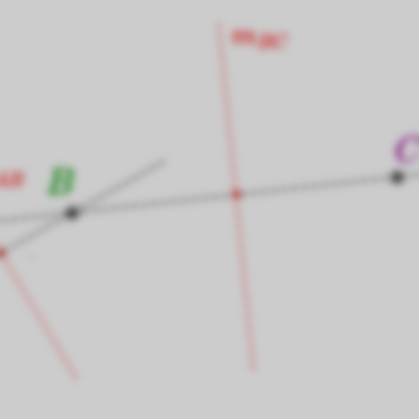
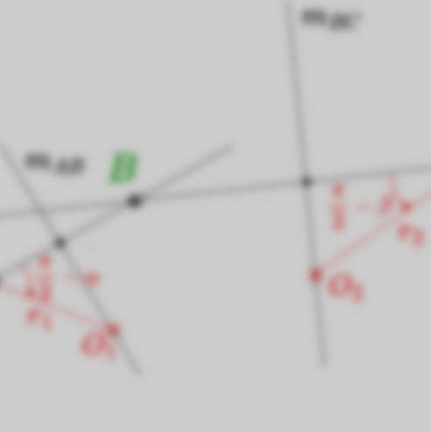
Resection using Geometric Algebra
Compass Ruler Algebra Methods
Iterative
Others
Vector GA Method
$$e^{iθ}$$
Tradicional
Methods
Cassini Construction
There are other methods that do not fit in with the above. For example, based on barycentric coordinates, complex numbers or graphical methods.
Origin
Collins Construction
$$\begin{matrix} & d_{1}=v_{1}+\frac{v_{1}}{tan⁡α}σ_{12}=\frac{v_{1}}{sin⁡α}e^{(90−α)σ_{12}} \\ & d_{2}=v_{2}−\frac{v_{2}}{tan⁡β}σ_{12}=\frac{v_{2}}{sin⁡β}e^{(β−90)σ_{12}}\end{matrix}$$
Collins
Willerding
Tienstra
$$p=\left(d_{1}∧d\right)d^{−1}=−\left(d_{2}∧d\right)d^{−1}=\left(d_{1}∧d_{2}\right)d^{−1}$$

Slide 14
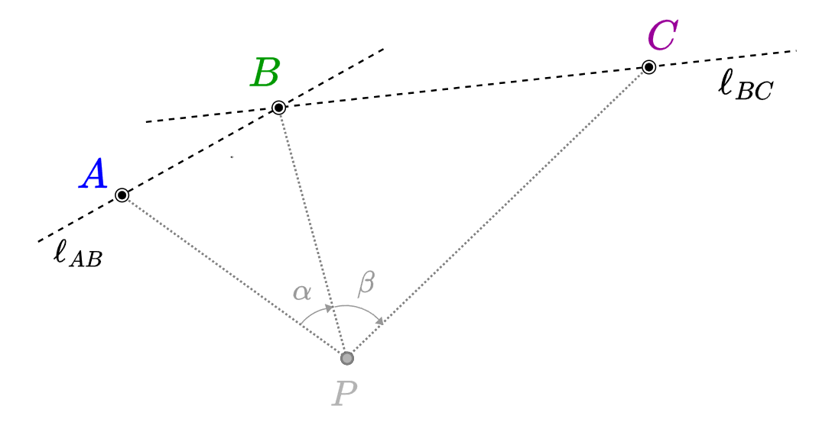
Resection using Geometric Algebra
Compass Ruler Algebra Methods
Cassini Construction
Vector GA Method
Collins Construction
Origin
The Cassini method provides a solution to the resection problem by leveraging the inscribed angle theorem.

Slide 15
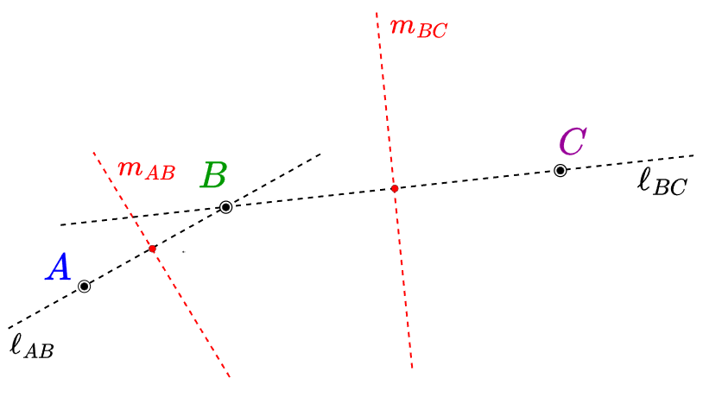
Resection using Geometric Algebra
Compass Ruler Algebra Methods
Cassini Construction
Vector GA Method
Collins Construction
Origin
$$\begin{aligned}&L_{AB}=a∧b∧σ_{∞} \\ &L_{BC}=c∧b∧σ_{∞}\end{aligned}\begin{aligned}&L_{AB}=a∧b∧σ_{∞} \\ &L_{BC}=c∧b∧σ_{∞}\end{aligned}$$

Slide 16
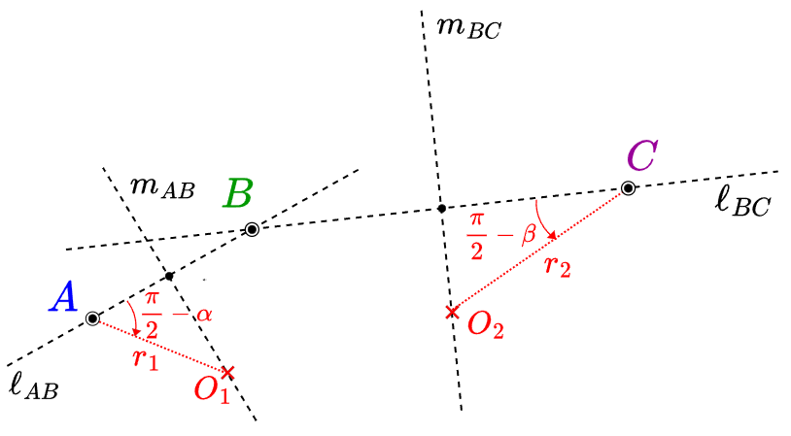
Resection using Geometric Algebra
Compass Ruler Algebra Methods
Cassini Construction
Vector GA Method
Collins Construction
$$\begin{aligned}M_{AB}=(a−b)^{∗} \\ M_{BC}=(b−c)^{∗}\end{aligned}$$

Slide 17
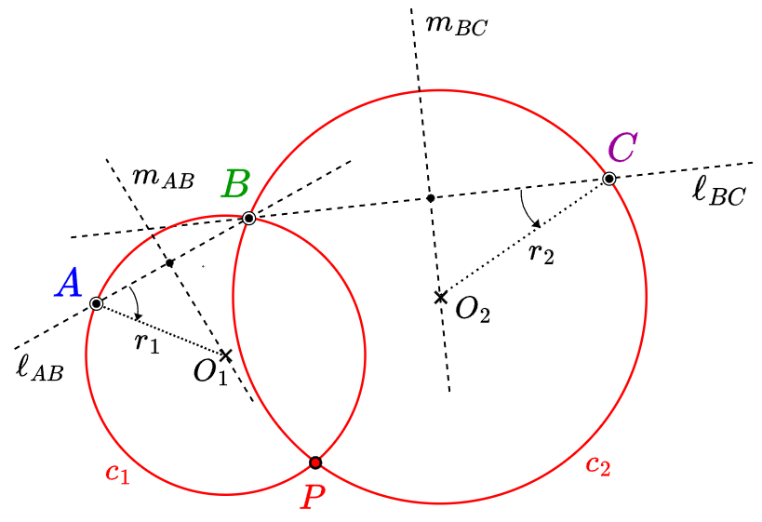
Resection using Geometric Algebra
Compass Ruler Algebra Methods
Cassini Construction
Vector GA Method
Collins Construction
$$\begin{aligned}&L_{AO}=D_{A}L_{AB}{\tilde{D}}_{A} \\ &L_{CO}=D_{C}L_{BC}{\tilde{D}}_{C}\end{aligned}$$
$$\begin{aligned}&O_{1}=M_{AB}∨L_{AO} \\ &O_{2}=M_{BC}∨L_{CO}\end{aligned}$$

Slide 18
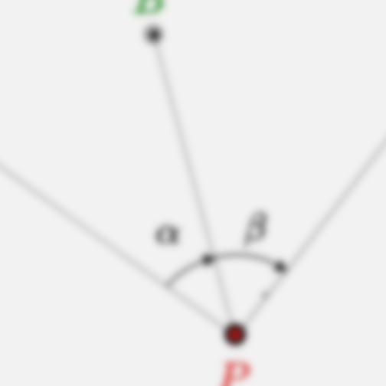
Resection using Geometric Algebra
Compass Ruler Algebra Methods
Cassini Construction
Vector GA Method
$$\begin{aligned}&c_{1}=o_{1}−\frac{1}{2}{r_{1}}^{2}σ_{∞} \\ &c_{2}=o_{2}−\frac{1}{2}{r_{2}}^{2}σ_{∞}\end{aligned}$$
Collins Construction
$$P=c_{1}∨c_{2}$$

Slide 19
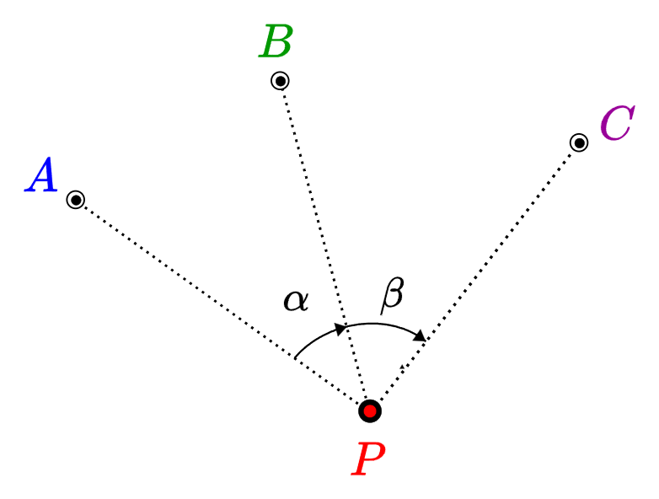
Resection using Geometric Algebra
Compass Ruler Algebra Methods
Collins Construction
Vector GA Method
The graphical method of Collins provides a solution using the intersection of the line passing through the point B and the so-called Collins auxiliary point E with the circle containing the points A, C and E.
Cassini Construction

Slide 20
Resection using Geometric Algebra
Compass Ruler Algebra Methods
Collins Construction
Vector GA Method
Cassini Construction
$$L_{AC}=a∧c∧σ_{∞}$$

Slide 21
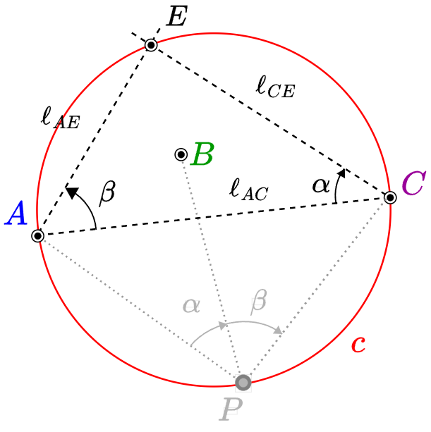
Resection using Geometric Algebra
Compass Ruler Algebra Methods
Collins Construction
Vector GA Method
Cassini Construction
$$\begin{aligned}&L_{AE}=D_{A}L_{AC}{\tilde{D}}_{A} \\ &L_{CE}=D_{C}L_{AC}{\tilde{D}}_{C}\end{aligned}$$
$$E=L_{AE}∨L_{CE}$$

Slide 22
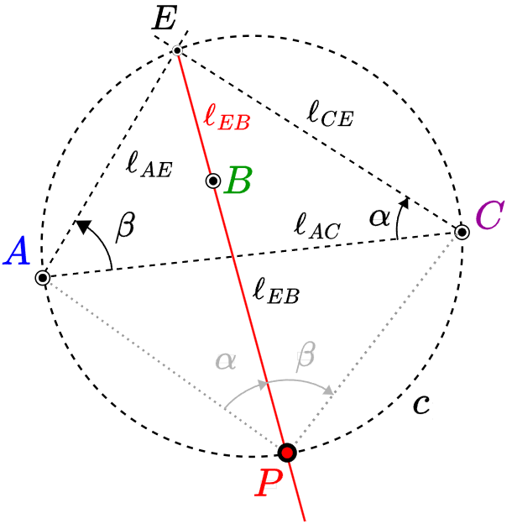
Resection using Geometric Algebra
Compass Ruler Algebra Methods
Collins Construction
Vector GA Method
Cassini Construction
$$C=a∧c∧e$$

Slide 23
Resection using Geometric Algebra
Compass Ruler Algebra Methods
Collins Construction
Vector GA Method
Cassini Construction
$$L_{EB}=e∧b∧σ_{∞}$$
$$P=L_{EB}∨C$$

Slide 24
Benchmarks
C#
GA-FuL library
A comprehensive set of benchmarks was conducted, comparing our algorithms against top-efficient. Each algorithm was executed ${10}^{6}$ times at random locations.

Slide 25
Benchmarks
83%
C#
GA-FuL library
#6
A comprehensive set of benchmarks was conducted, comparing our algorithms against top-efficient. Each algorithm was executed ${10}^{6}$ times at random locations.

Slide 26
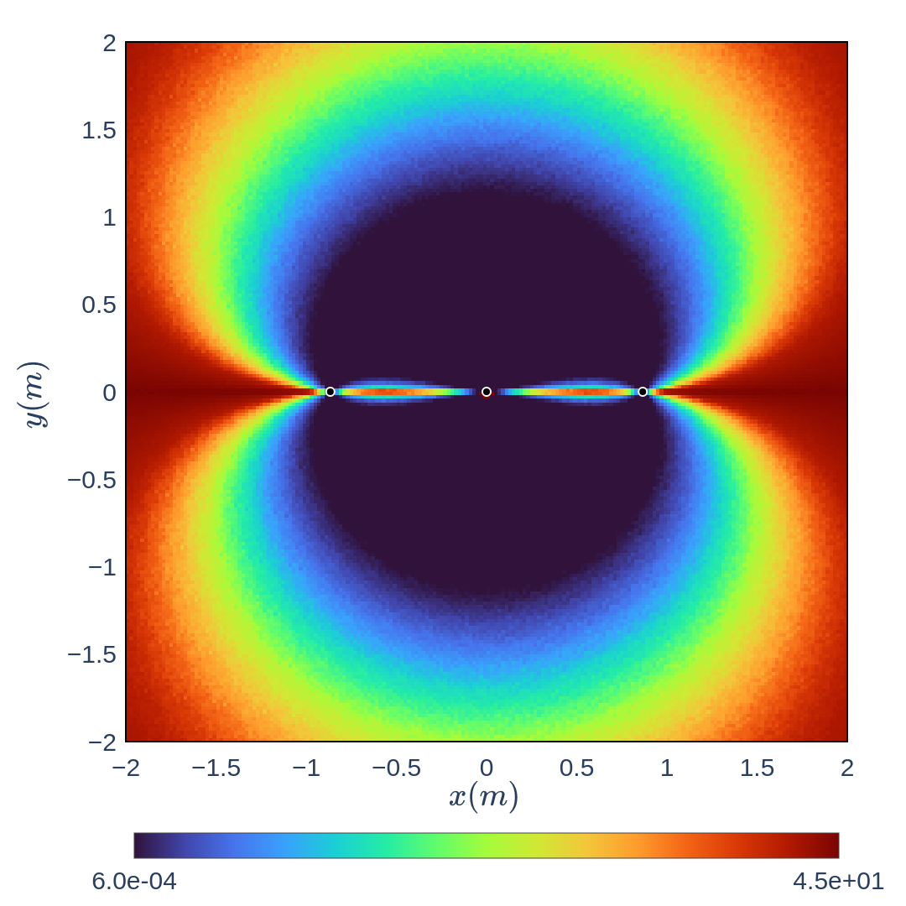
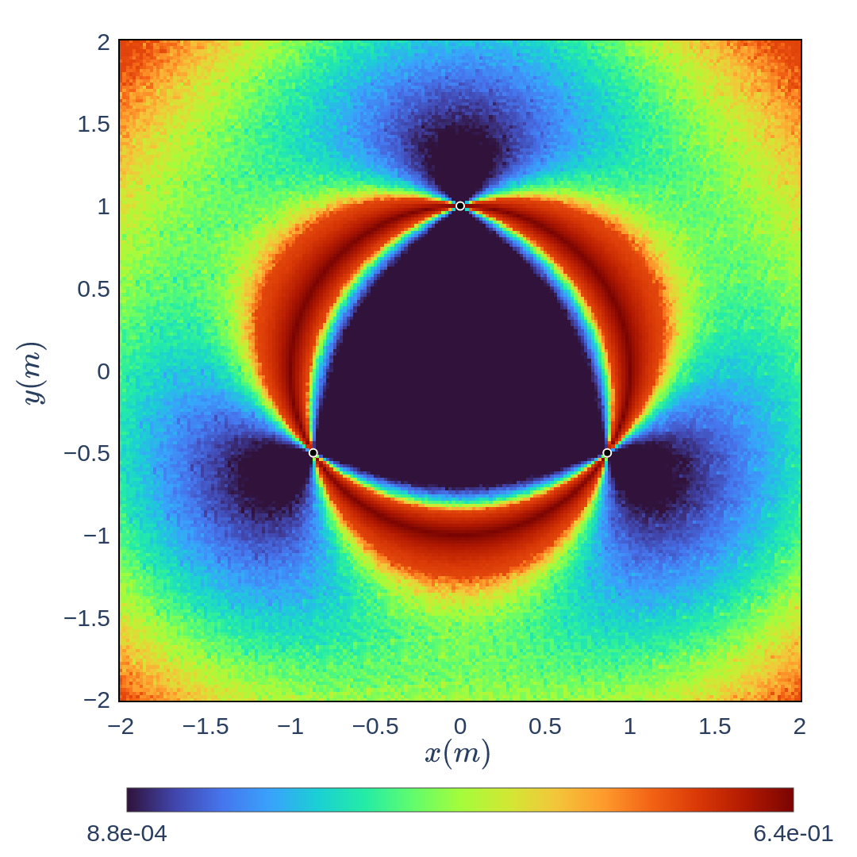
Uncertainty analysis
Gaussian
noise
B
4 m
A
C
$$α$$
$$β$$
2 cm
4 m

Slide 27
Uncertainty analysis
Gaussian
noise
B
4 m
A
C
Equilateral Triangle
4 m

Slide 28
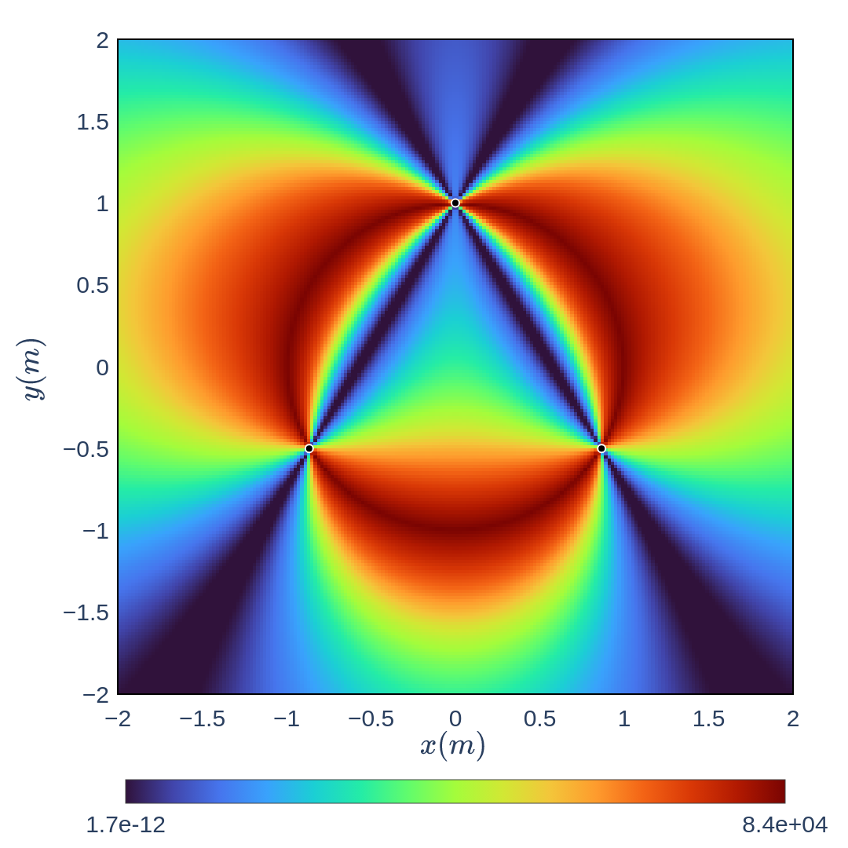
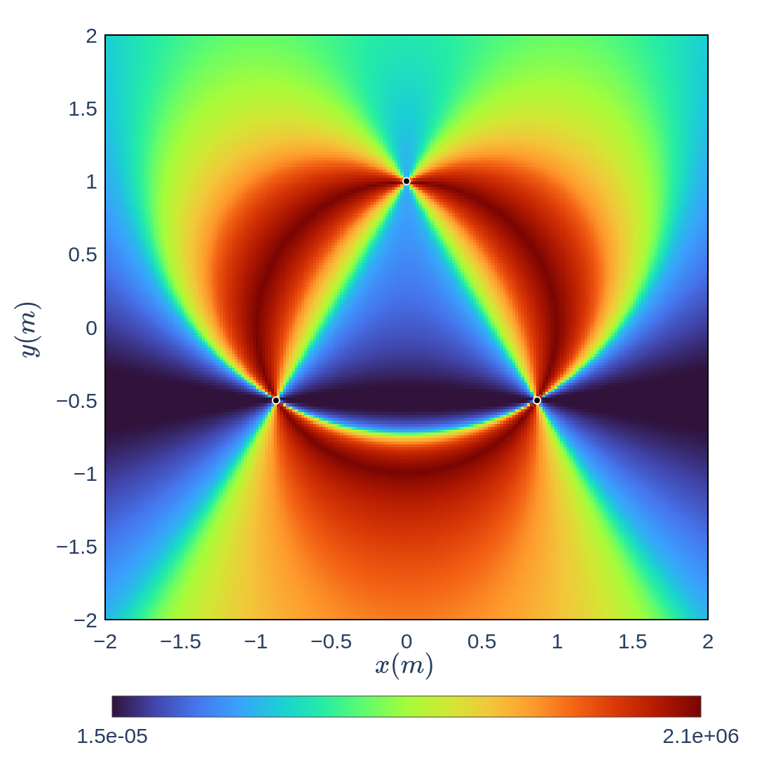
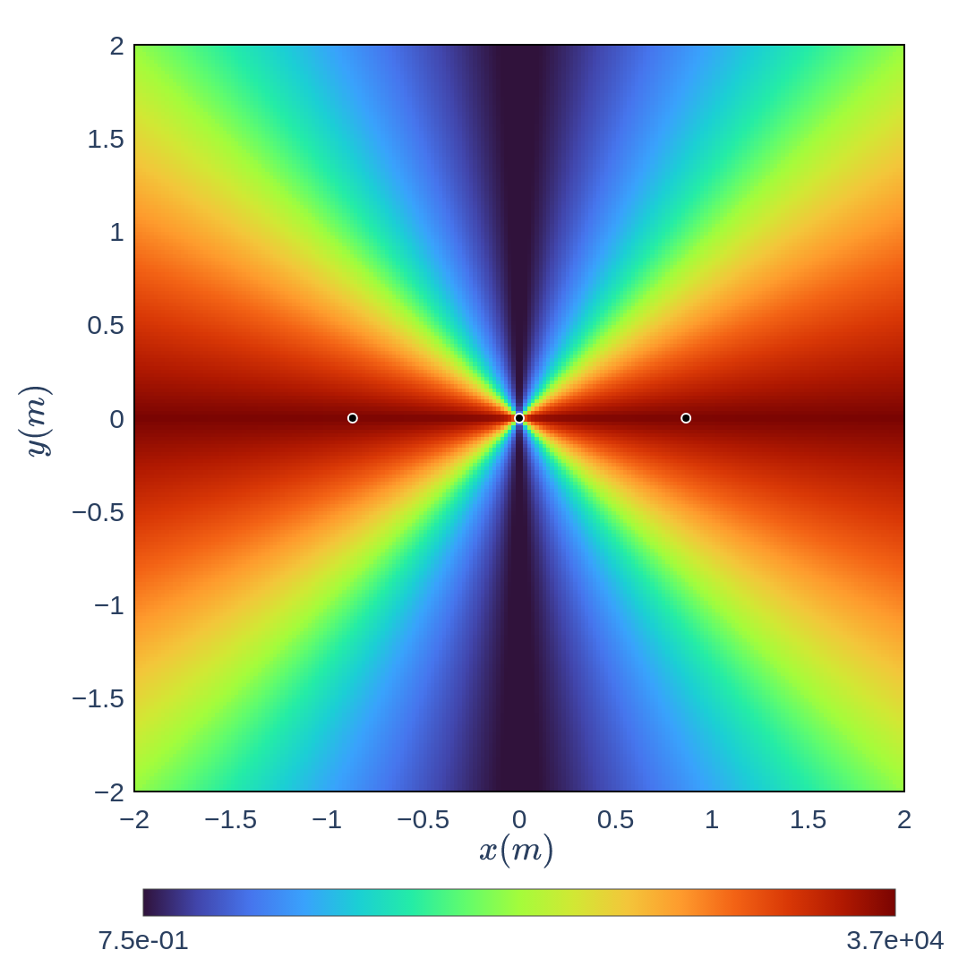
Uncertainty analysis
Colinear

Slide 29
Uncertainty analysis
VGA Method
$$D=d^{2}$$

Slide 30
Uncertainty analysis
Collins Method
$$D=−2(e·b)$$

Slide 31
Uncertainty analysis
Cassini Method
$$D=−2(o_{1}·o_{2})$$

Slide 32
Uncertainty analysis
CONCLUSIONS
This article introduces a novel method for solving the two-dimensional resection problem using conformal geometric algebra (CGA). The CGA approach simplifies the problem by avoiding complex algebraic manipulations and coordinate transformations, offering a more intuitive and efficient solution. Numerical simulations confirm the method's accuracy and efficiency, suggesting its potential applications in fields like surveying, geodesy, computer graphics, robotics, and navigation.
Any questions?

Slide 33
CONCLUSIONS
This article introduces a novel method for solving the two-dimensional resection problem using conformal geometric algebra (CGA). The CGA approach simplifies the problem by avoiding complex algebraic manipulations and coordinate transformations, offering a more intuitive and efficient solution. Numerical simulations confirm the method's accuracy and efficiency, suggesting its potential applications in fields like surveying, geodesy, computer graphics, robotics, and navigation.
Any questions?

