Slide 1
Generalized Geometric Algebra Transformer
Yuxin Yao, Christian Hockey, Joan Lasenby
CUED, Cambridge

Slide 2
Context
Latest Geometric Algebra Transformer : GATr
  First Transformer model in GA, with great potential in understanding the 3D geometry of input data.
  Fixed GA signature
Structure of Generalized Geometric Algebra Transformer (GGATr)
Experiments
  Camera Pose Estimation
  N-Body Dynamics
  Protein Structure Prediction
Ref: Brehmer, J., De Haan, P., Behrends, S., and Cohen, T. S. (2024). Geometric algebra transformer. Advances in Neural Information Processing Systems, 36.
Ruhe, D., Brandstetter, J., and Forré, P. (2024). Clifford group equivariant neural networks. Advances in Neural
Information Processing Systems, 36.
1
Notes:
Motivation:
Currently there are Simplify the GA layers, using similar analogies as common neural networks. We want to demonstrate that the simplified networks can work well.
Our GA network maintained equivariants end to end
2 current most GA neural networks are hard-coded in specific algebra signature, eg GATR in PGA.
3 Apply the generalized GA layers to various problems including camera pose estimation, n-body simulation and protein structure prediction
4. We built Various GA layers, and as a result a generalized GATr networks structure which works on any GA signatures including the ones containing basis squares to 0.
TFGA
Maintain end-to-end equivariance in the G GATr

Slide 3
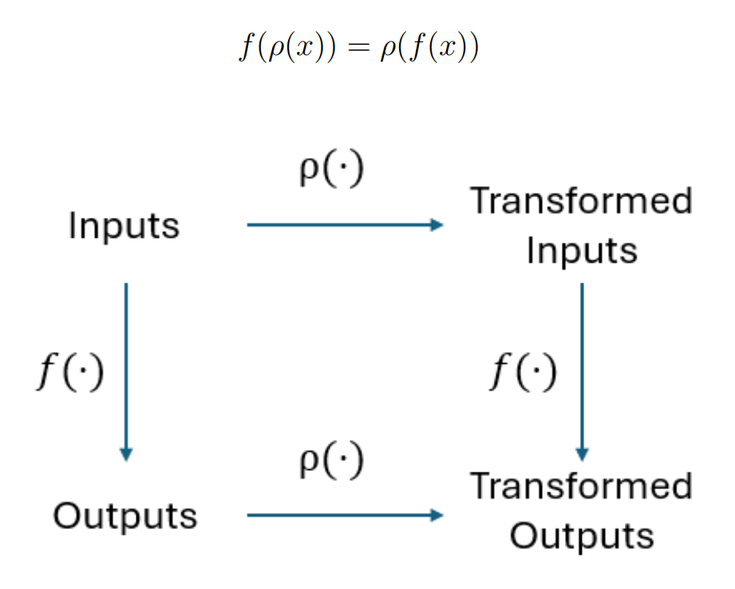
Equivariance
Ref: Brehmer, J., De Haan, P., Behrends, S., and Cohen, T. S. (2024). Geometric algebra transformer. Advances in Neural Information Processing Systems, 36.
Ruhe, D., Brandstetter, J., and Forré, P. (2024). Clifford group equivariant neural networks. Advances in Neural
Information Processing Systems, 36.
2
Notes:
Add slide – equi good
Mention difficult equi in NN
Equivariance is important in natural sciences, helpful with modeling the dynamics of complex physical systems. Also for some deep learning tasks, if the neural network is equivariant to transformations, it can work better with the unseen data.

Slide 4
Structure of GA Layers
Linear Layer
Non-linear Layer
Sandwich product layer
Layer Norm
Geometric Product Layer
Join Layer
3

Slide 5
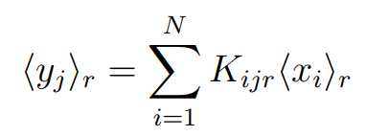

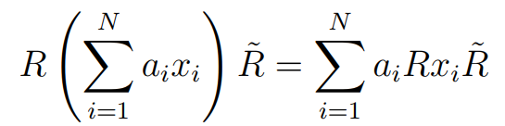

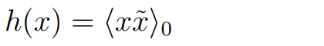
Structure of GA Layers
Linear Layer
  Equivariance proof: 1.
Non-linear Layer where
2.
4
Notes:
TFGA
Linear Layer:
Analogous to the dense layer.
(explain input & output, mv): input is x, the brack indicates the r-grade projection of the multivector x, the output is y.
similar to CGENN,
a weighted sum of each grade
Proof of eq follows the equivariance of grade projection and the linearity of the geometric product
Non-linear layer：
Increase network complexity. Linear and nonlinear functions together, approximate to an universal approximator
Taking the scalar parts or all grades (cubic factor may lead to numerical instability)
Equivariant by the equivariantce of grade projection
Used sigmoid non-linearity instead of GELU, better fitting with fewer blocks
Require gate,h, to maintain equivariance.
Xx^-1 involves more info, as involved all element of given grades .

Slide 6
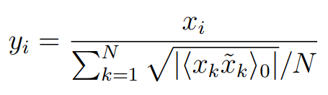
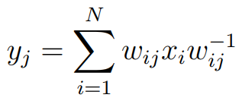
Structure of GA Layers
Layer Norm
Sandwich Product Layer (Not equivariant)
Dimension of
Multivector weights
5
Notes:
Layer norm:
- Help alleviate the instability in a deep neural network.
- In GATr they used a layer norm that do grade-by-grade normalization, prone to instability especially with ga vector squears not to 1
- We only take the abs value of the 0 grade projection of the gp of the multivectors. , always +ve
Equivariant
- The N here is the dimension of the input, N is the number of dimension of the x.
GP layer:
Geometric product of two lienar layer output
( Linear -> linear layer)
Further grade mixing
Join layer ( only necessary to GA with basis ^2 = 0) Proved dual, antidual and outer product are equiviariant, so join equivariant
The dual is found by choosing an orthogonal basis and thus the wedge of x and dual of x gives the pseudoscalar .

Slide 7





Structure of GA Layers
Geometric Product Layer
Join/Meet Layer
  define Join/meet:
  Finding the dual by. If exist basis square to 0
                Otherwise
6
Notes:
Layer norm:
- Help alleviate the instability in a deep neural network.
- In GATr they used a layer norm that do grade-by-grade normalization, prone to instability especially with ga vector squears not to 1
- We only take the abs value of the 0 grade projection of the gp of the multivectors. , always +ve
Equivariant
- The N here is the dimension of the input, N is the number of dimension of the x.
GP layer:
Geometric product of two lienar layer output
( Linear -> linear layer)
Further grade mixing
Join layer ( only necessary to GA with basis ^2 = 0) Proved dual, antidual and outer product are equiviariant, so join equivariant
The dual is found by choosing an orthogonal basis and thus the wedge of x and dual of x gives the pseudoscalar .

Slide 8
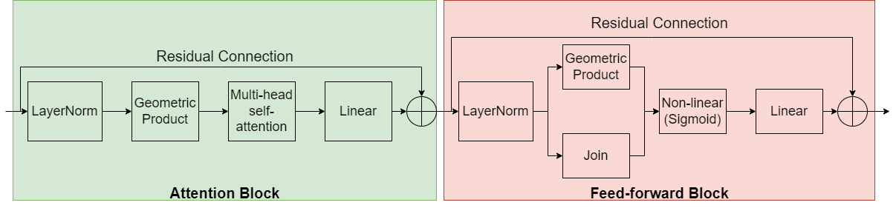
Structure of GGATr
7
Notes:
Our generalied GA network similar to GATr
Layernorm is used ,
avoid significant instability issues
We used the norm that devided by the average of the 0-grades part of the gp of the input. Avoid significant instability issued with certain algebras.
Unlike GATr we But used geometric product layer before the multi-head attention

Slide 9
Structure of GGATr
8
Notes:
Our generalied GA network similar to GATr
Layernorm is used ,
avoid significant instability issues
We used the norm that devided by the average of the 0-grades part of the gp of the input. Avoid significant instability issued with certain algebras.
Unlike GATr we But used geometric product layer before the multi-head attention

Slide 10
Structure of GGATr
9
Notes:
Our generalied GA network similar to GATr
But used geometric product layer before the multi-head attention. It help increase the grade mixing and hence the complexity before feeding into the attention block. More effective dot-protduct attention
Simpler inner product attention instead of ‘distance-aware’ dotproduct attention in GATr:
scalar part of the inner product between queries and keys could straightforwardly be used without omission of information.

Slide 11
Structure of GGATr
10
Notes:
Our generalied GA network similar to GATr
Simpler inner product attention instead of ‘distance-aware’ dotproduct attention in GATr:
scalar part of the inner product between queries and keys could straightforwardly be used without omission of information.
Used sigmoid non-linearity instead of GELU, better fitting with fewer blocks

Slide 12
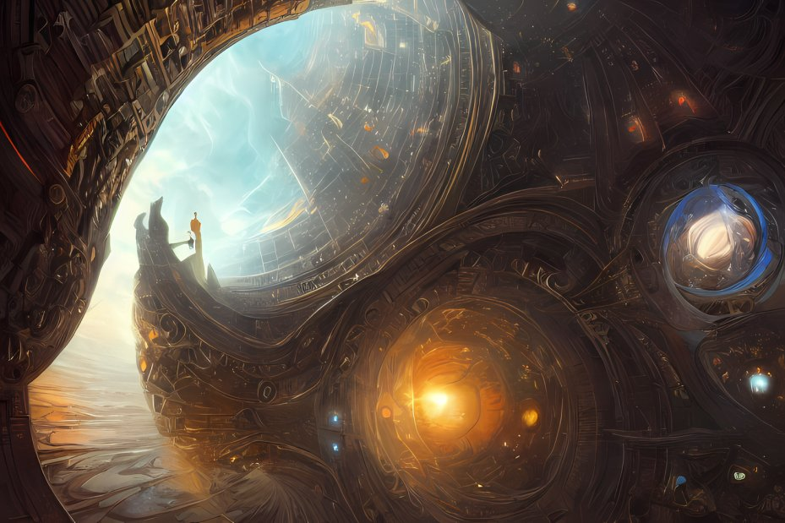



General Attention Mechanism
Self-attention: Focus on different parts of the input data with varying degrees of importance.
Multi-head self-attention: multiple self-attention operations parallelly, focusing on different aspects.
Query
What information do I want?
Each Input in sequence
Find Similarity
Key
What information do I have?
Value
Aggregate actual information I hold.
11
Notes:
Attention: allows the model to focus on specific parts of the input data when making predictions by using this attention mechanism.
Qkv are query, key, value tokens in common transformer architecture. They are multivectors here.
QKV are vectors are derived from the input data through learned linear transformations.
Q represent the element for which we want to computer the similarity relative to keys.
K Each element in the sequence has a key vector that is used to compute the relevance of that element to the query.
V:The value vector contains the information to be aggregated,
Softmax is the function that convert vector of values into a probability distribution. Sum of the output vector =1. Find relative weight to each element in sequence.
Attention：
Instead of using the distance aware
nb is the total number of bases, the attention is averaged over the the layer dimension. (scale the values)
Nc is the length of the query and key, divided by 8nc is because the inner product of PGA is a dot product on 8 of the 16 dimensions , ignoring the dimensions containing e0.
simplicity and
very closely reflects the dot product form of attention
similar performances

Slide 13
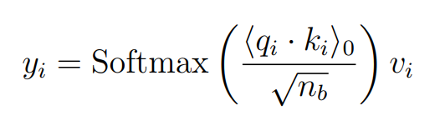
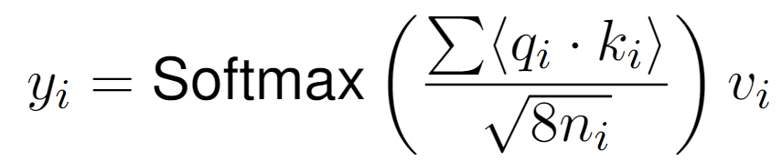

Attention Head
Our Attention Mechanism
QualComm’s GATr: Distance-aware dot product attention
Number of basis
Number of basis not squares to 0
12
Notes:
Attention: allows the model to focus on specific parts of the input data when making predictions by using this attention mechanism.
Qkv are query, key, value tokens in common transformer architecture. They are multivectors here.
QKV are vectors are derived from the input data through learned linear transformations.
Q represent the element for which we want to computer the similarity relative to keys.
K Each element in the sequence has a key vector that is used to compute the relevance of that element to the query.
V:The value vector contains the information to be aggregated,
Softmax is the function that convert vector of values into a probability distribution. Sum of the output vector =1. Find relative weight to each element in sequence.
Attention：
Instead of using the distance aware
nb is the total number of bases, the attention is averaged over the the layer dimension. (scale the values)
Nc is the length of the query and key, divided by 8nc is because the inner product of PGA is a dot product on 8 of the 16 dimensions , ignoring the dimensions containing e0.
simplicity and
very closely reflects the dot product form of attention
similar performances

Slide 14
Structure of GGATr – Feed-forward Block
13
Notes:
The layernorm is used to help with the stability of the transformer structure because multiple transformer blocks can be added.

Slide 15
Structure of GGATr – Feed-forward Block
14
Notes:
The layernorm is used to help with the stability of the transformer structure because multiple transformer blocks can be added.
by a geometric product layer (as described in section 3.2.5) concatenated with a join layer. The two layers all increase the grade mixing of the input and hence the complexity of the model.
CGA ok with/wo join
PG must with join
Linear layer is used to map the output to desired shape

Slide 16
Structure of GGATr – Feed-forward Block
15
Notes:
Our generalied GA network similar to GATr
Used sigmoid non-linearity instead of GELU, better fitting with fewer blocks, better results in experiments.

Slide 17
Structure of GGATr – Feed-forward Block
16
Notes:
Our generalied GA network similar to GATr
Used sigmoid non-linearity instead of GELU, better fitting with fewer blocks, better results in experiments.

Slide 18
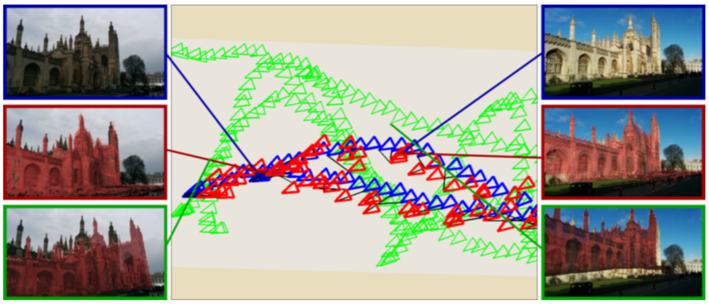
Experiments – PoseNet
Ref: Kendall, A., Grimes, M., and Cipolla, R. (2015). Posenet: A convolutional network for real-time 6-dof camera relocalization. In Proceedings of the IEEE international conference on computer vision, pages 2938–2946.
17
Notes:
Predict pose of the camera used to take a picture given a picture of a known scene
The inceptionV3 Imagenet CNN model is used to estimate the camera pose from the given image. To investigate the impact of using GA, we removed the final layer of the inceptionV3 net.

Slide 19
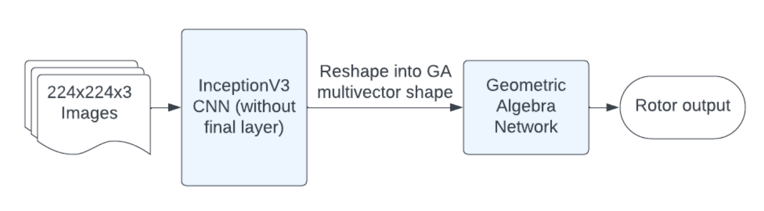
Experiments – PoseNet
Reshape into GA
multivector shape
Motor output
In one-up GA
Ref: Pepe, A., Lasenby, J., and Buchholz, S. (2024). Cgaposenet+ gcan: A geometric clifford algebra network for geometry-aware camera pose regression. In Proceedings of the IEEE/CVF Winter Conference on Applications of Computer Vision, pages 6593–6603
18
Notes:
Predict pose of the camera used to take a picture given a picture of a known scene
The inceptionV3 Imagenet CNN model is used to estimate the camera pose from the given image. To investigate the impact of using GA, we removed the final layer of the inceptionV3 net.
Investigate whether an equivariant feed-forward network was a useful addition even when the network was not end-to-end equivariant!
Input is images and the output
-non equivariant backbone, followed by equivariant GA feedforward network
-we used one-up, which is CGA(4,0,0) containing 4 basis square to 1. We embed the translation and rotation to the motor.
We compared 4 different GA network structure

Slide 20
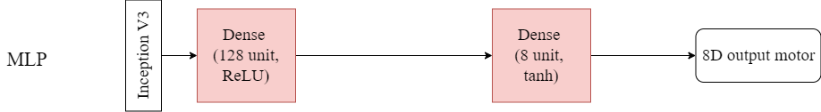
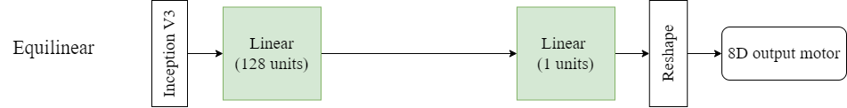
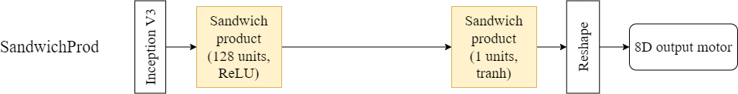
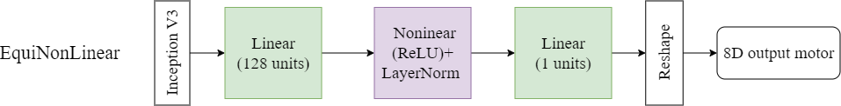
Posenet – Network Structure
Non-GA
GA
19
Notes:
In all of the 3 structures, we only tested the three combination of the GA layers, without the GA transformer structure.
Didn’t use layernorm because the networks are shallow
Compared 3 GA networks with MLP layers.
Reshape:map the 16D output, containing 8 non-zero component, to 8 D motor for comparison with the true motor.

Slide 21
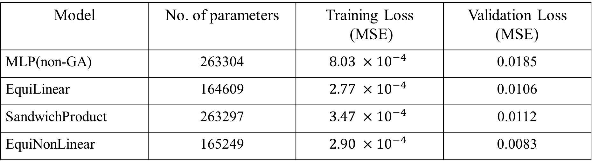
PoseNet - Evaluation
Model | No. of parameters | Training Loss (MSE) | Validation Loss (MSE)
MLP(non-GA) | 263304 | $$8.03 ×{10}^{−4}$$ | 0.0185
EquiLinear | 164609 | $$2.77 ×{10}^{−4}$$ | 0.0106
SandwichProduct | 263297 | $$3.47 ×{10}^{−4}$$ | 0.0112
EquiNonLinear | 165249 | $$2.90 ×{10}^{−4}$$ | 0.0083
All networks with rotor product layer perform better.
Non-linearity further improve the performances.
20
Notes:
All GA networks , less parameter but all substantially better performances
Thus, equivariant layers following non-equivariant network still valuable and improves.
Also the use of non-linearity improve the performance, adding complexity with lower parameter cost.
Also able to visualize the intermediate output, convergence

Slide 22
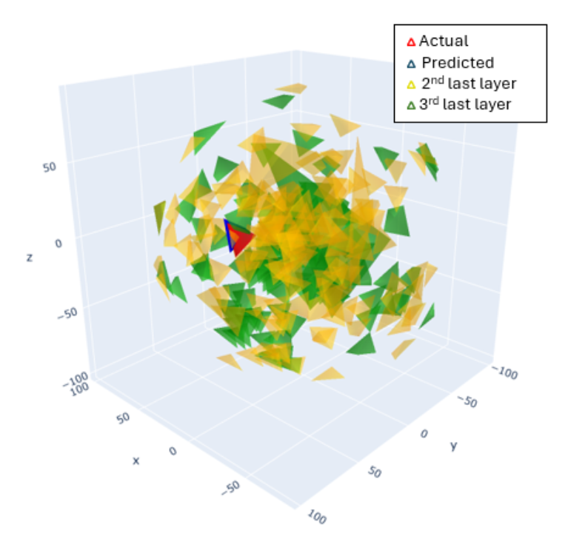
PoseNet - Visualization
Visualize the convergence of camera poses
Intermediate tensors are motors
Ref: Pepe, A., Lasenby, J., and Buchholz, S. (2024). Cgaposenet+ gcan: A geometric clifford algebra network for geometry-aware camera pose regression. In Proceedings of the IEEE/CVF Winter Conference on Applications of Computer Vision, pages 6593–6603
21
Notes:
All GA networks , less parameter but all substantially better performances
Thus, equivariant layers following non-equivariant network still valuable and improves.
Also the use of non-linearity improve the performance, adding complexity with lower parameter cost.
Also able to visualize the intermediate output, convergence

Slide 23
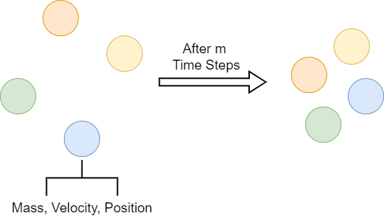
N-body Dynamics Problem
22
Notes:
We also tested on the N-body dynamics problem, and compared our results with the GATr from QualComm.
The model was given as inputs the masses, initial velocities and initial positions of 4 bodies moving under gravity and needed to predict their positions after a fixed amount of time had elapsed
Generated 10,000 samples simulating 100 time stpes of 10^-3 secs for each sample. 0.1 sec gap between input output.
Used CGA (4,0,1) conformal GATr with different number of blocks and hyperparamaters, compared with the MLP layers as benchmark
We also tested on a longer timestep gap for testing the scaling of the transformer.
Used the euler simulator as in GATr

Slide 24

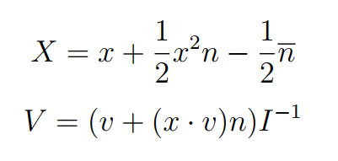
N-body Dynamics - Embedding
In CGA, we define and
Mass: Scalar
Position:
Velocity:
23
Notes:
Mention another convention (n^inf, n_0)
Standard
The embedding of V is absed on the rigid body dynamics in cga. Taking dual for velocity
It also used the additional dimension of the input vector and avoid adding the points and velocity vectors into the same basis.

Slide 25
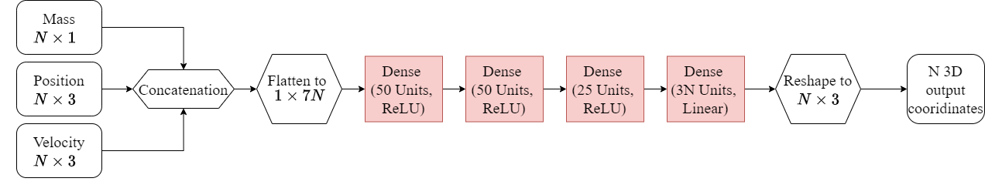
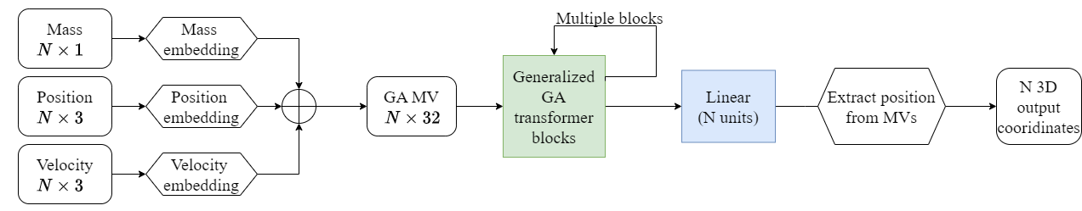
N-body Dynamics
MLP
GGATr
24
Notes:
CGA block was configured with 2 units per head, 4 heads, 4 hidden units

Slide 26
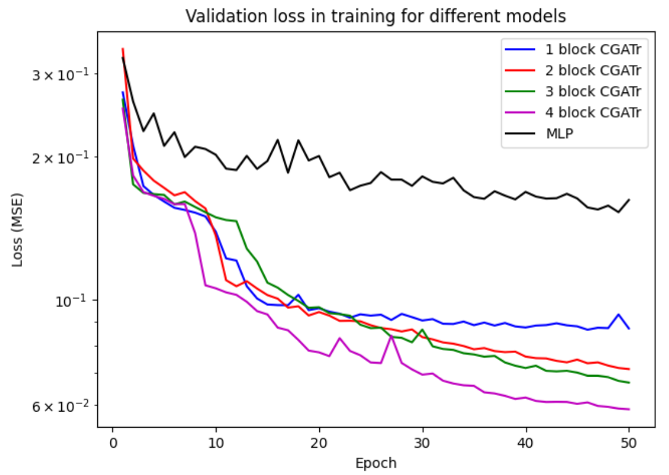
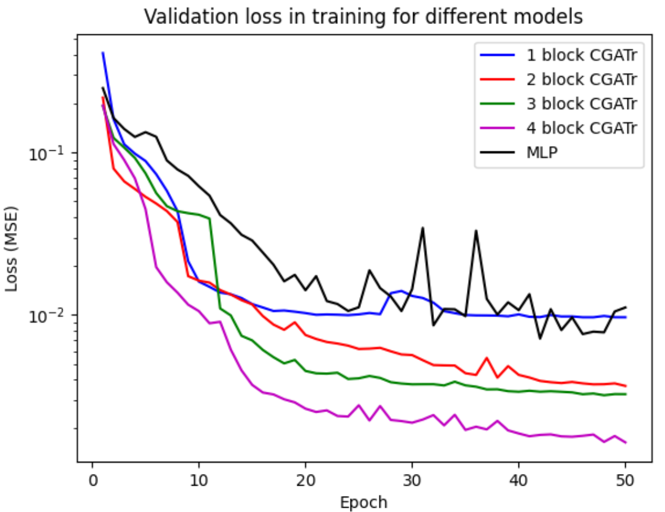
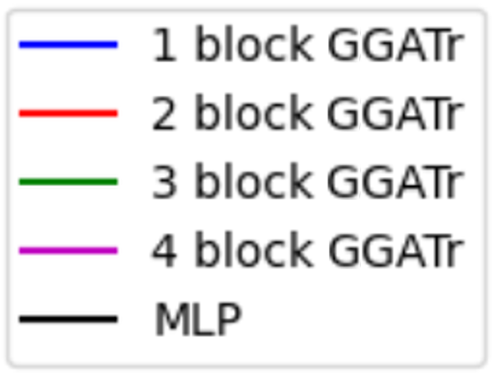
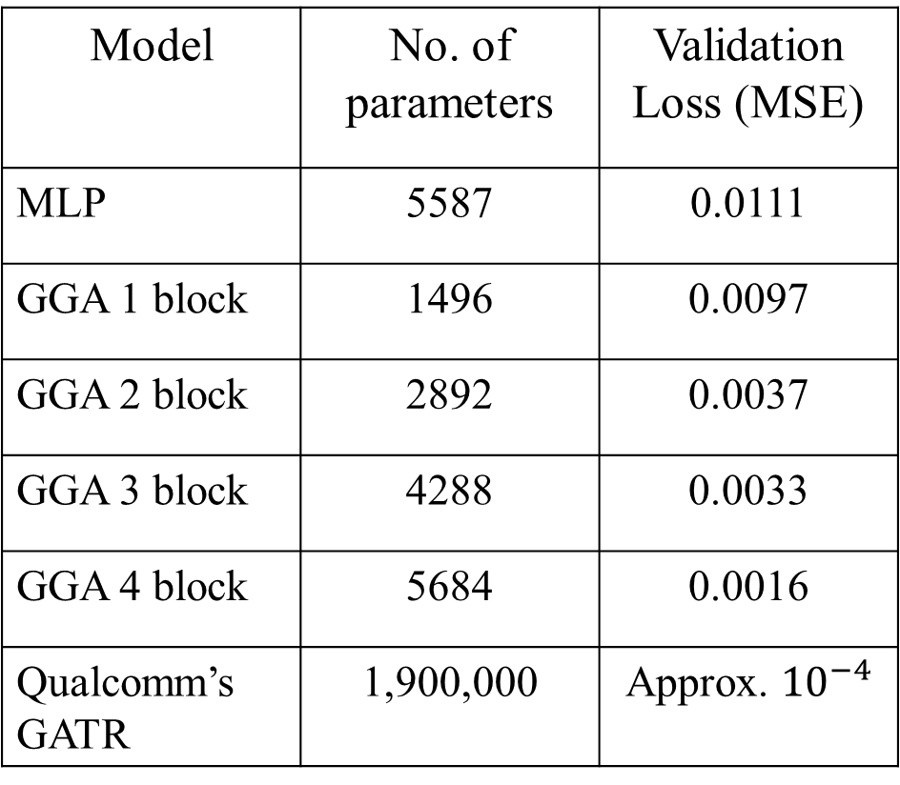
N-body Dynamics – Evaluation – 0.1s gap
Model | No. of parameters | Validation Loss (MSE)
MLP | 5587 | 0.0111
GGA 1 block | 1496 | 0.0097
GGA 2 block | 2892 | 0.0037
GGA 3 block | 4288 | 0.0033
GGA 4 block | 5684 | 0.0016
Qualcomm’s GATR | 1,900,000 | Approx. ${10}^{−4}$
25
Notes:
MSE between position
it scales very well with increasing numbers of blocks, and greatly outperforms a non-geometric architecture
Although the validation loss is 10x worse than the GATr, the GATr had 1.9 millions parameter, slower training.
but we only have about 5,000.
Still a valid setup for a Small network

Slide 27
N-body Dynamics – 1s gap
26
Notes:
It shows that for more difficult geometric problems, non-geometric methods are even more outclassed by the GA transformer.
Valuable setup with strong inductive bias in a small neural network .
strong inductive bias on a smaller network, showing that it can still be a valuable set-up, even when limited computational resources are available.

Slide 28
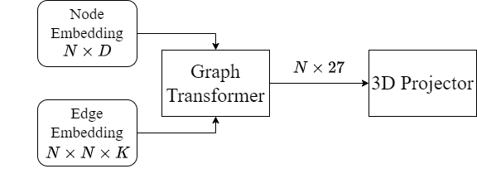
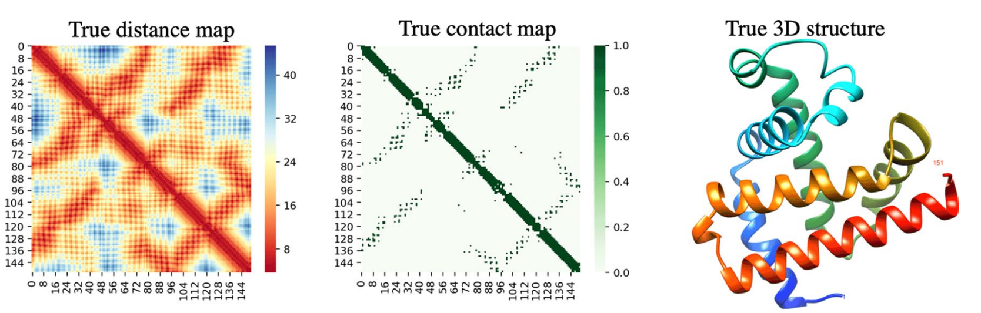
Protein Structure Prediction
Edge: Adjacency matrix
  Pairwise features, eg. Distance Map
Node: Individual features
3D protein structure
Predict
Pepe, Alberto, Sven Buchholz, and Joan Lasenby. "Clifford Group Equivariant Neural Network Layers for Protein Structure Prediction." Northern Lights Deep Learning Conference. PMLR, 2024.
27
Notes:
The problem of predicting protein structure uses information about corresponding amino acid sequences and the individual amino acides.
PDNet
Embed into graphs, edge stores the pairwise feature, nodes stores the individual features
CGENN layers for PSP
extracting information from the graph connectivity and obtaining a new node representation
projecting the new nodes into 3D Euclidean space, which is the 3D coordinates of the amino acids
and information about individual amino acids and pairwise information between them (including a distance map containing distances between pairs of amino acids)
The data is expressed in graph, with an adjacency matrix representation for each edge feature, each individual feature stored as a list as the node. We used the pdnet dataset
Consturct an end-to-end protein structure prediction model.
we know that the output is of a geometric nature, and that applying equivariant GA layers after a nonequivariant backbone can still yield positive results,

Slide 29
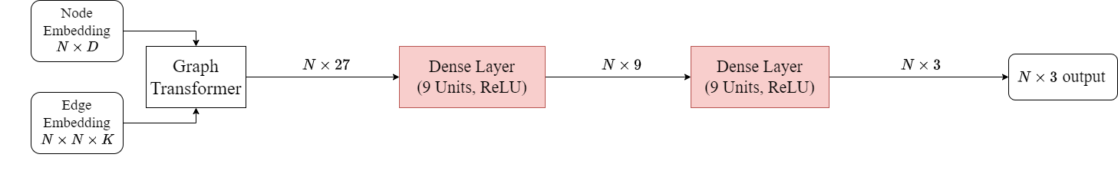
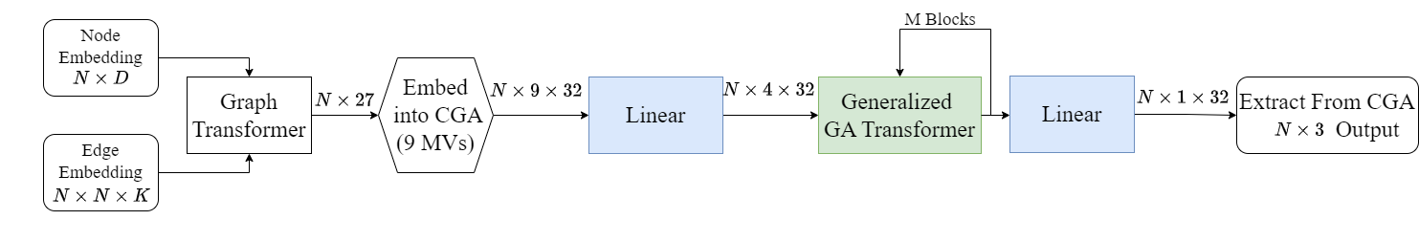
Protein Structure Prediction - Structure
MLP
GGATr
Ref: Pepe, Alberto, Sven Buchholz, and Joan Lasenby. "Clifford Group Equivariant Neural Network Layers for Protein Structure Prediction." Northern Lights Deep Learning Conference. PMLR, 2024.
28
Notes:
In CGENN work, the author implemented a graph transformer with predict the 27 dimensional features of each aminoacide, containing the individual features of the nodes, and then feed to a linear layer projecting the 27 D feature to 3D coordinates. Of the amino acids.
In alberto’s work, he treats the 27 dimensional features as 9 3D position proposals for the amino acids, and embed them into rigid multivectors.
substituted multivector linear layers, and Fully connected geometric products. We substitute the feed-forward network with our GA setups and compare with the MLP baseline.
Embed 27 features as points to the GA(4,1,0) group.
Compared multiple GA layers and CGA transformer.

Slide 30
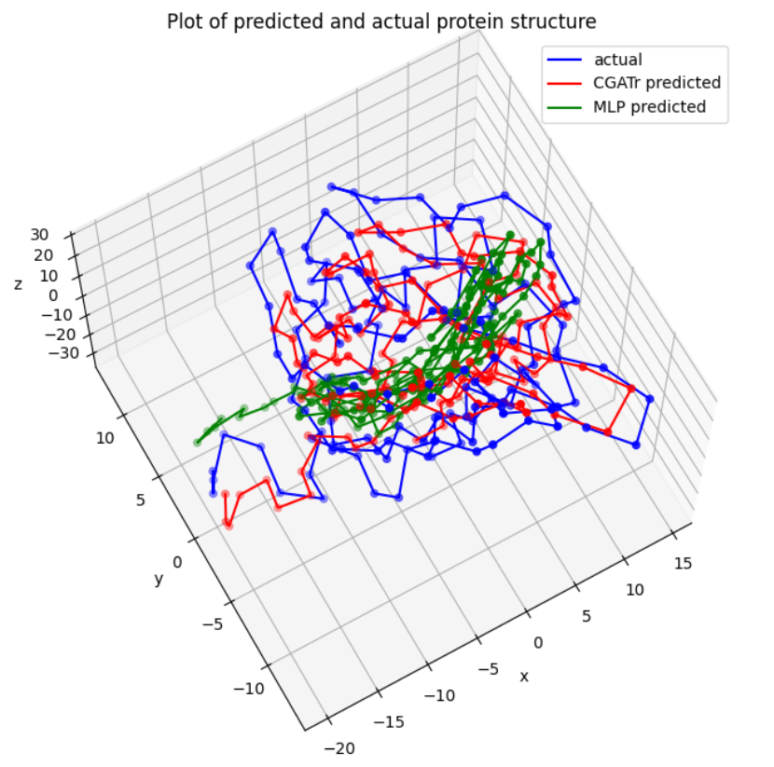
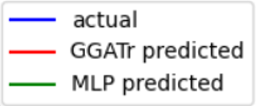

Protein Structure Prediction – Evaluation
Dataset | Model | Distance map MAE | Coordinate MSE
Validation | MLP | 4.63 | 17.33
 | GGATr 1 block | 2.57 | 8.54
 | GGATr 2 block | 2.02 | 5.56
Test | MLP | 4.24 | 13.66
 | GGATr 1 block | 2.39 | 6.79
 | GGATr 2 block | 1.79 | 4.03
 | CGENN – Single FCGP | 4.10 | NA
 | CGENN – double FCGP | 3.05 | NA
Pepe, Alberto, Sven Buchholz, and Joan Lasenby. "Clifford Group Equivariant Neural Network Layers for Protein Structure Prediction." Northern Lights Deep Learning Conference. PMLR, 2024.
29
Notes:
1 block significantly outperform the MLP, non GA and GA layer tested in alberto’s paper (compare
MSE of coordinates
MAE :difference between the distance maps computed using the predicted coordinates to the ones which the input gt distance maps
Visualization shows : although the MLP seems to recognise the general shape of the protein, it fails to detect the details of a given protein’s structure , thus GA better performance
Clearly, the 2-block CGA transformer performs far better on all datasets
Again demonstrate the performance still scales favourably with increasing transformer block as shown in N-body dynamic problem.

Slide 31
Conclusion
Constructed a Generalized Geometric Algebra Transformer.
Demonstrated the impact of GA networks even used with an non-equivariant backbone.
The GA equivariant layer outperforms both non-geometric methods and non-equivariant methods.
30
Notes:
.(different algebra fits different tasks, so good with generalized.)

Slide 32
Thank you!
30
Notes:
.(different algebra fits different tasks, so good with generalized.)

Slide 33

Q&A – Equivariance Proof
Non-linear Layer
  Function h is invariant to versor sandwich product -> constant scalar for given x
  Gated nonlinearity follows the equivariance of multiplication by scalar
  Involve all element of a grade in nonlinearty but instable
30
Notes:
.(different algebra fits different tasks, so good with generalized.)

Slide 34

Q&A – Equivariance Proof
Join Layer
  Equivariance of Dual
  Pesudoscalar invariance.
  Define outer product:
  Express multivectors to sum of n+1 multivectors of a single grades.
  By linearity of outer product, and equivariance of grade projection.
  Dual, antidual and outer product are equivariant, so Join Layer equivariant.
30
Notes:
.(different algebra fits different tasks, so good with generalized.)

Slide 35
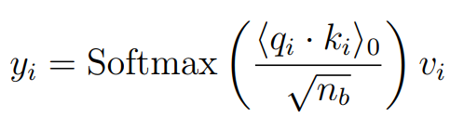


Q&A – Equivariance Proof
Self-Attention Layer
Use Same logic form
Invariant function: 0-grade projection of inner product
30
Notes:
.(different algebra fits different tasks, so good with generalized.)

Slide 36
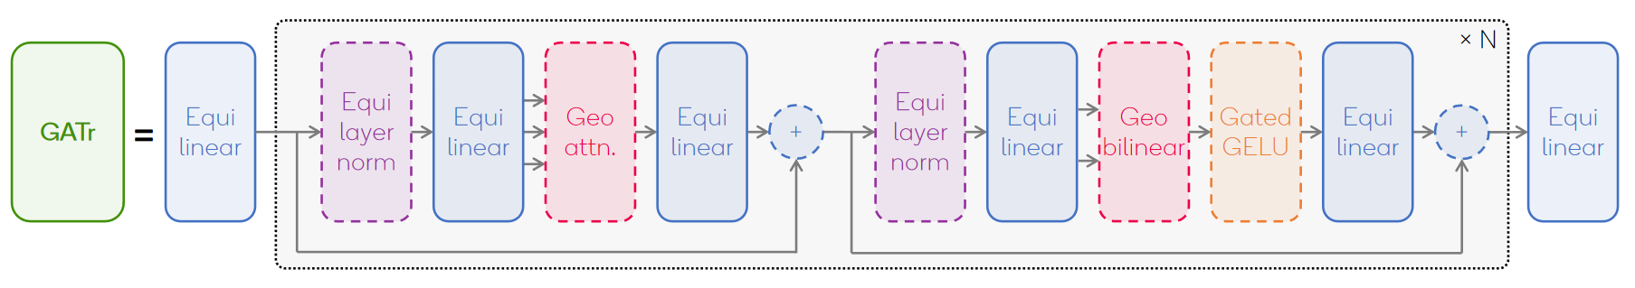

Q&A – QualComm’s GATr
LayerNorm: GatedGeLU
GeoBilinear: EquiJoin & GP layer
Ref: Brehmer, J., De Haan, P., Behrends, S., and Cohen, T. S. (2024). Geometric algebra transformer. Advances in Neural Information Processing Systems, 36.
30
Notes:
.(different algebra fits different tasks, so good with generalized.)

Slide 37
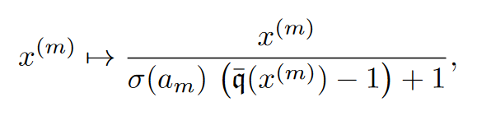
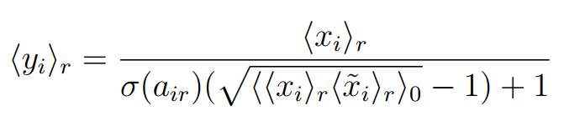
Q&A – CGENN
LayerNorm
Ref: Ruhe, D., Brandstetter, J., and Forré, P. (2024). Clifford group equivariant neural networks. Advances in Neural
Information Processing Systems, 36.
30
Notes:
.(different algebra fits different tasks, so good with generalized.)

